Slide 1
Modeling Performance Evaluation and Sensitivity Overview
Heather Simon, Norm Possiel, Shannon Koplitz, Sharon Phillips, Barron Henderson, Brett Gantt
U.S. EPA OAQPS

Slide 2
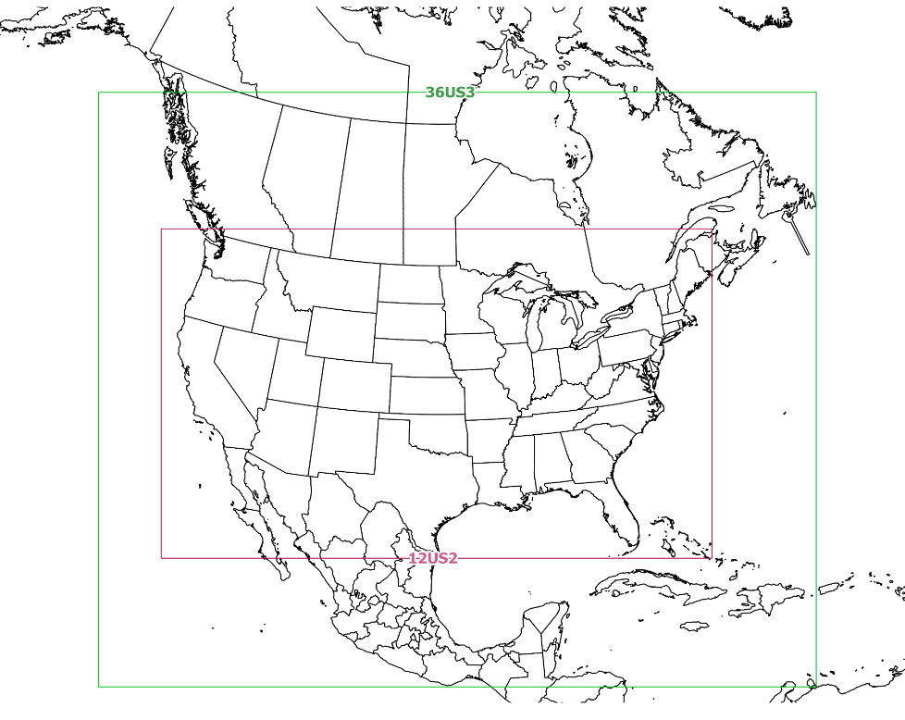
EPA OAQPS Modeling Set-up for 2016v1
Annual model simulations with CMAQv5.3.1 and CAMxv7 beta6
CB6r3 chemical mechanism
POA treated as non-volatile (did not use VBS)
No bidirectional ammonia flux
Nested 36km and 12km domains with 35 vertical layers
Potential 4 km modeling for domains (NE/MW/CA)
Meteorology from WRFv3.8
Initial and Boundary Conditions from
Hemispheric CMAQv5.2.1 with 2016fe emis
See extra slides for additional details
36km
12km

Slide 3
Completed model sensitivity runs
CMAQ
Multiple deposition schemes & with and without Bidirectional NH3 flux
Various meteorological options and PBL schemes in WRF
GEOS-Chem boundary conditions
Updated VOC speciation
Lightning NO
CAMx
Vertical diffusivity, “Kv”, sensitivities
Ammonia deposition sensitivities
GEOS-Chem boundary conditions

Slide 4
Model Performance Framework
Performance broken out into different spatial and temporal scales
Spatial: NOAA climate region
Temporal:
Winter (DJF), Spring (MAM), Summer (JJA), Fall (SON)
Ozone season (May-September)
Pollutants
PM2.5 components (sulfate, nitrate, OC, EC)
Ozone, with focus on days > 60 ppb
NOx (see extra slides)
Highlights given from base CMAQ and CAMx Simulations and from key sensitivity simulations
Results are still preliminary – this is a work in progress

Slide 5
PM2.5

Slide 6
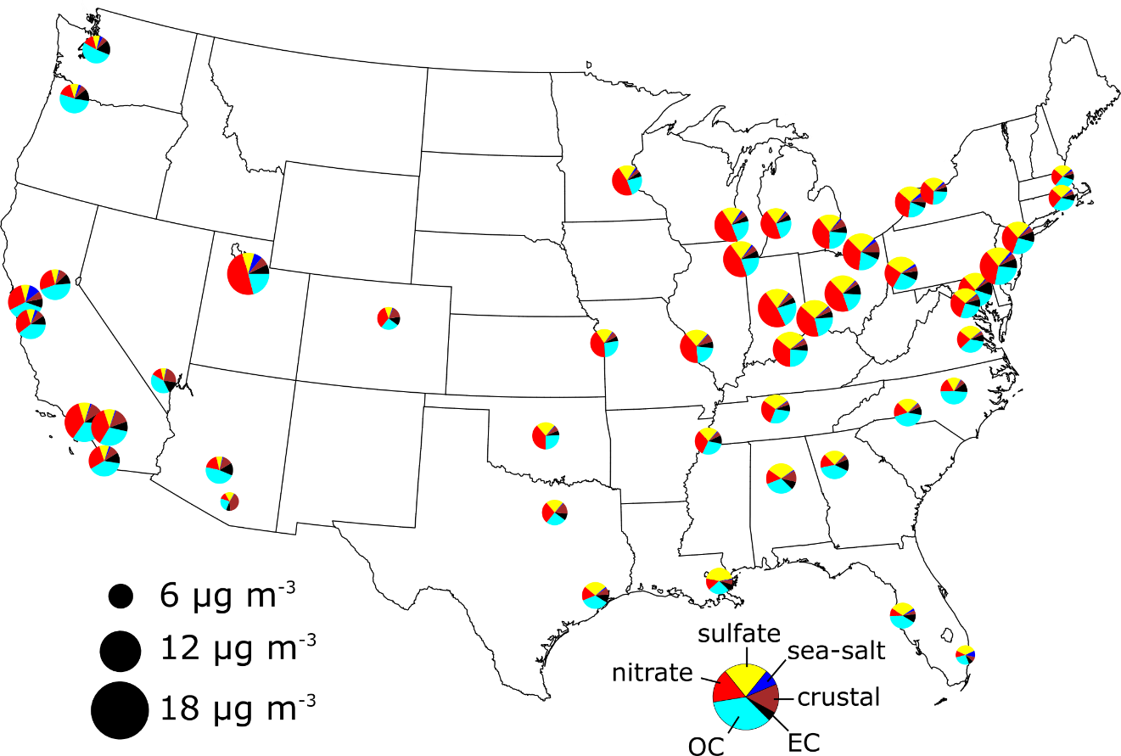
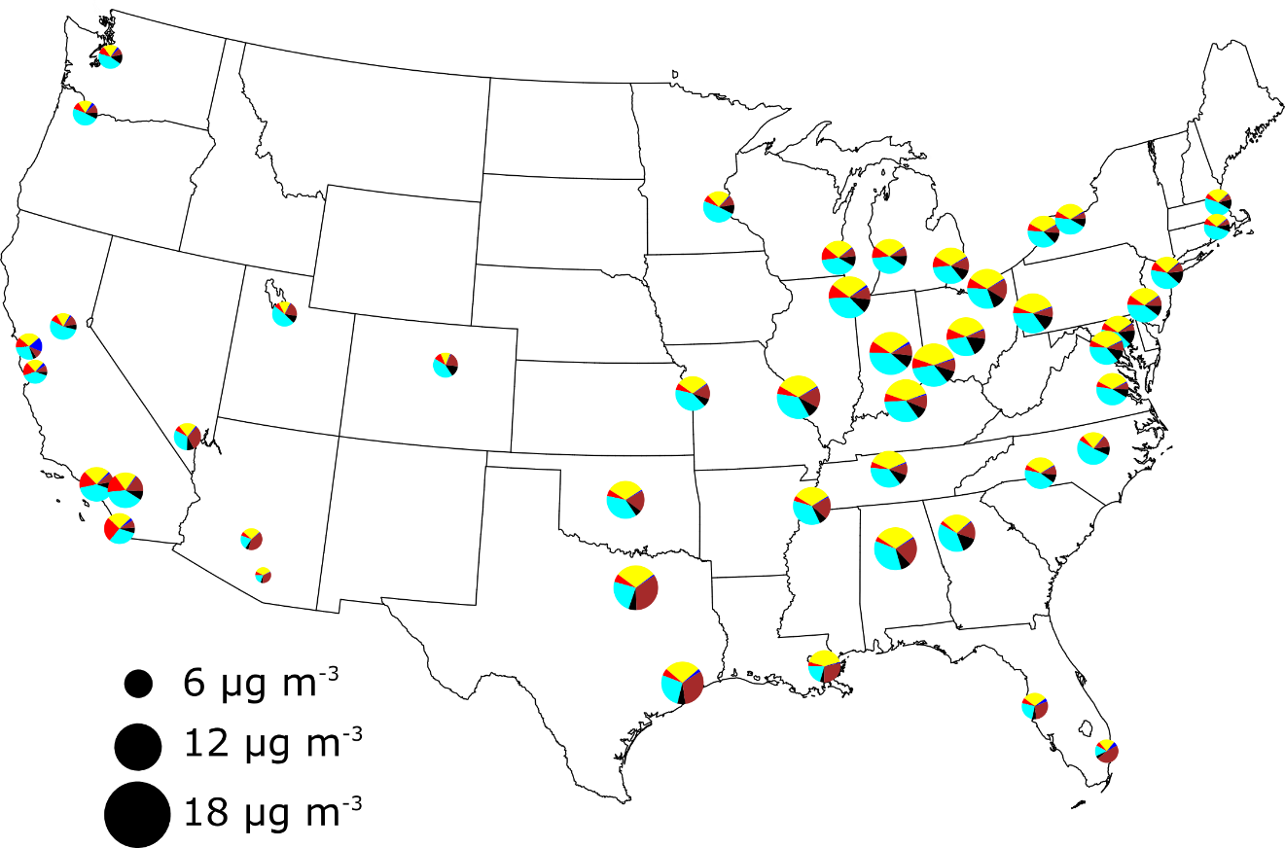
Measured PM composition across the US (2013-2015)
Winter
Summer
Composition varies by location but there are some overarching seasonal patterns
Winter: Major components of PM2.5 are nitrate, sulfate and OC
Summer: Major components of PM2.5 are sulfate and OC (nitrate still important in CA)

Slide 7
Sulfate spatial patterns in CMAQ and CAMx
Base CAMx
Base CMAQ
January
Focus evaluation on locations with high sulfate concs
Winter: entire Eastern US
Summer: Ohio River Valley
July

Slide 8
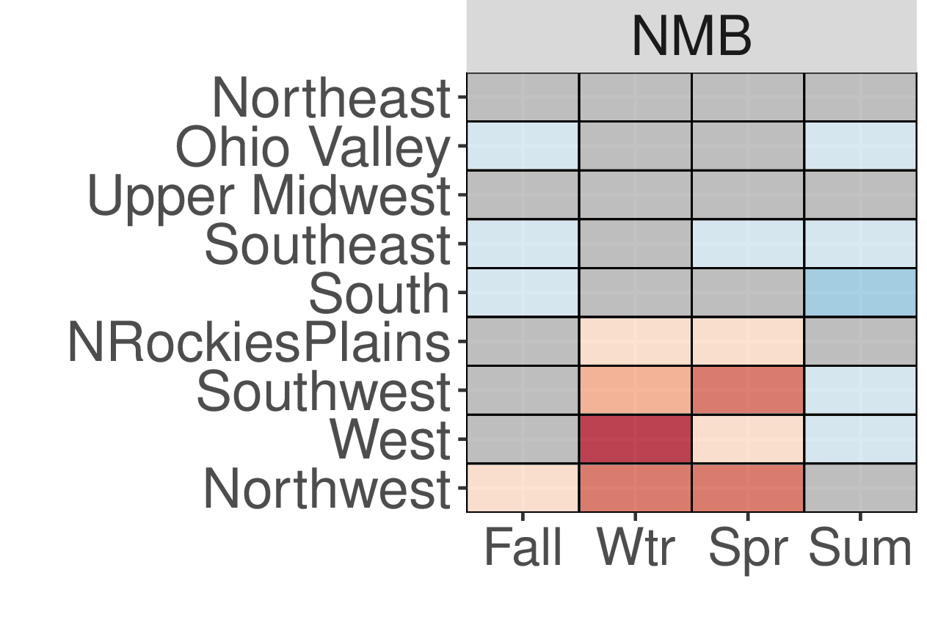
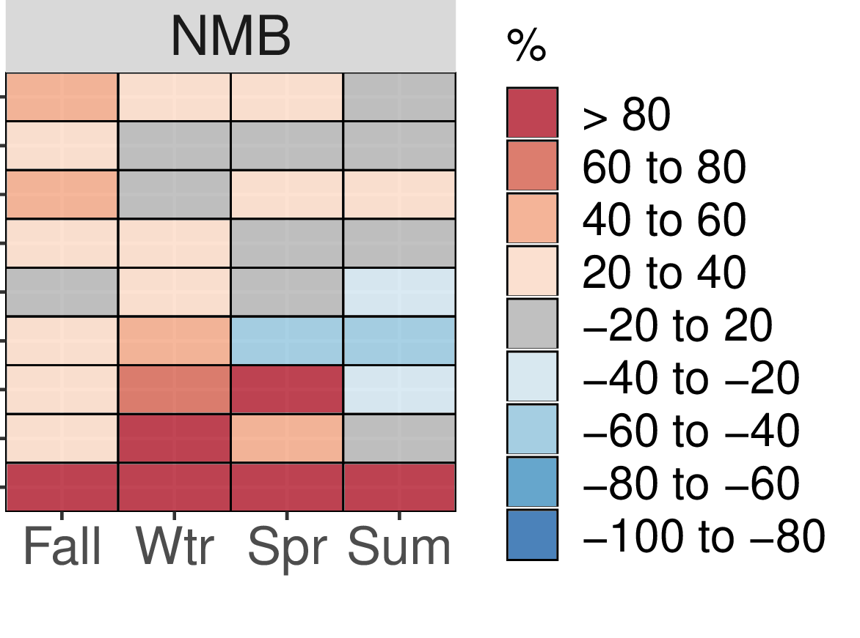
Sulfate Bias (%) – Overview
Sulfate overprediction in the Western US where concentrations are very low – very small absolute bias
Winter Eastern US: CAMx bias is mostly between -20% and +40%, CMAQ underpredictions are generally less than -20%
Summer Ohio River Valley: CAMx bias is between -20% and +20%, CMAQ bias is between -40% and -20%
CMAQ 2016fh
CAMx 2016fh

Slide 9
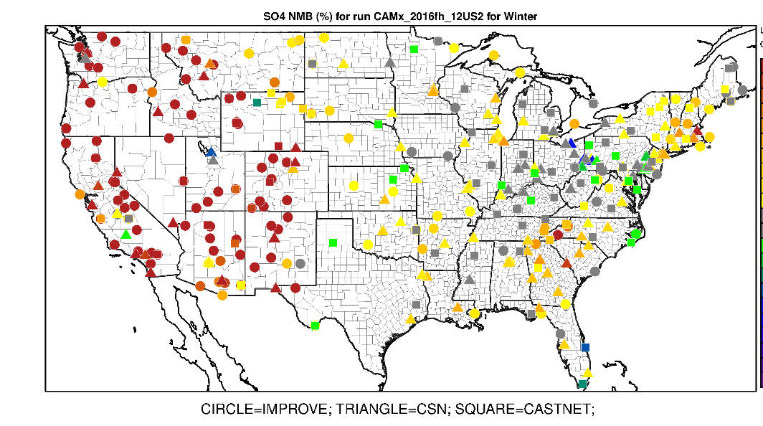
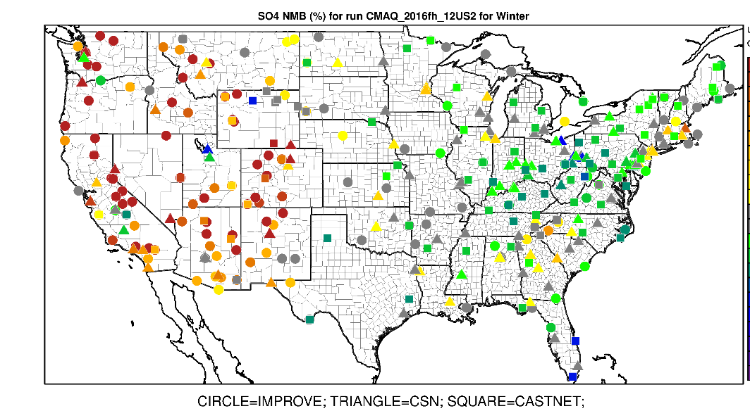
Sulfate – 2016fh National NMB (%)
CAMx
CMAQ
Winter
Summer
Sulfate overprediction in the Western US where concentrations are very low – very small absolute bias
Winter Eastern US: CAMx bias is mostly between -20% and +40%, CMAQ underpredictions are generally less than -20%
Summer Ohio River Valley: CAMx bias is between -20% and +20%, CMAQ bias is between -40% and -20%

Slide 10
Key Sulfate Sensitivity Simulations
NoahYSU - Base
STAGE - Base
GEOSChem - Base
January
July
Base run sulfate overprediction in the Western US where concentrations are very low – very small absolute bias
Winter Eastern US: Base run CAMx bias is mostly between -20% and +40%, Base run CMAQ underpredictions are generally less than -20%
Summer Ohio River Valley: Base run CAMx bias is between -20% and +20%, Base run CMAQ bias is between -40% and -20%

Slide 11
Nitrate spatial patterns in CMAQ and CAMx
Base CAMx
Base CMAQ
January
Focus evaluation on locations with high nitrate concs
Winter: Midwest US and California
Note both models miss high winter nitrate in Salt Lake City
Spring: Midwest US
Summer (not shown): California
April

Slide 12
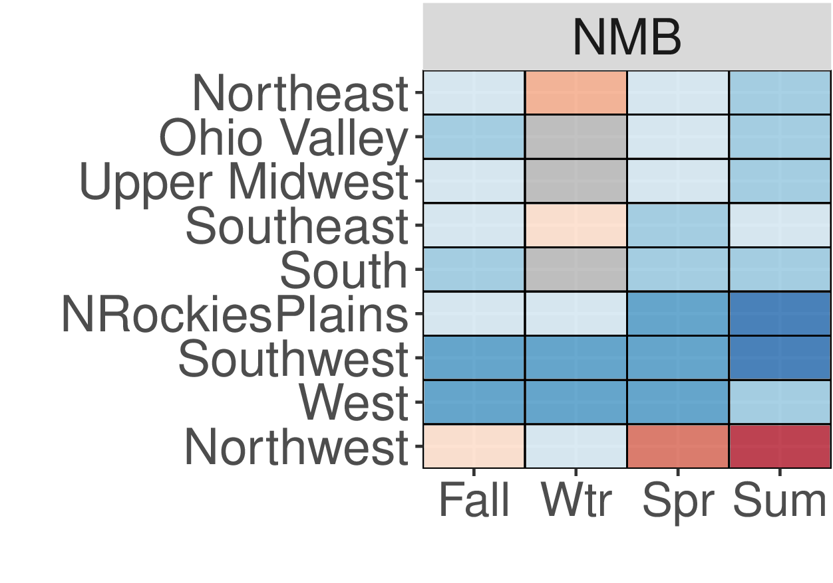
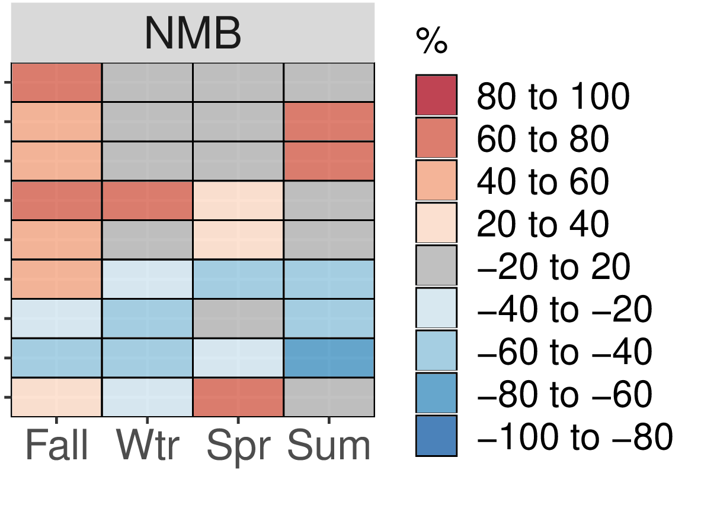
Nitrate Bias (%) – Overview
California (West region) underpredicted year-round in both models
Winter Eastern US : Midwest shows underpredictions up to 20%, Northeast corridor shows overpredictions in both models , underpredictions in SW (including SLC), performance in both models look similar
Spring Midwest: CMAQ is underpredicted, CAMx bias is between -20% and + 20%
CMAQ 2016fh
CAMx 2016fh

Slide 13
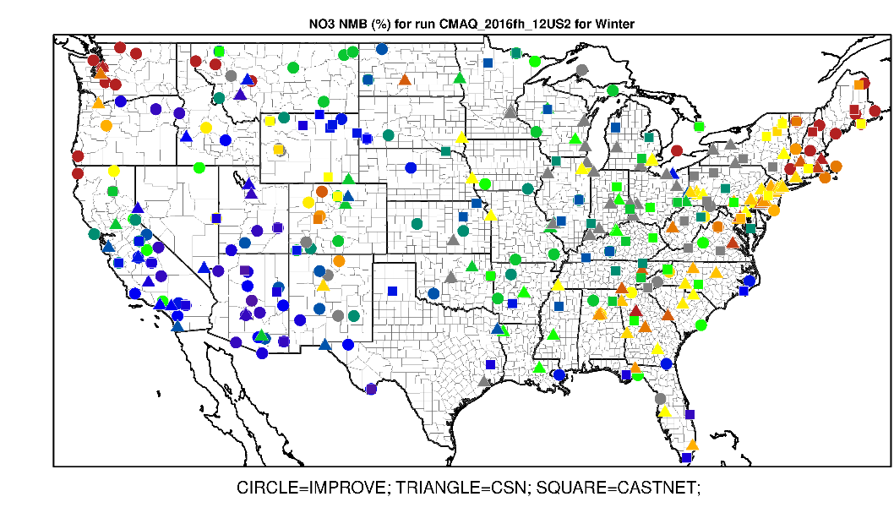
Nitrate – 2016fh National NMB (%)
CAMx
CMAQ
Winter
Spring
California (West region) underpredicted year-round in both models
Winter Eastern US : Midwest shows underpredictions up to 20%, Northeast corridor shows overpredictions in both models , underpredictions in SW (including SLC), performance in both models look similar
Spring Midwest: CMAQ is underpredicted, CAMx bias is between -20% and + 20%

Slide 14
Key Nitrate Sensitivity Simulations: CAMx
BiDi - Base
Rscale - Base
GEOSChem - Base
January
April
California (West region) underpredicted year-round in both base run model simulations
Winter Eastern US base model runs: Midwest shows underpredictions up to 20%, Northeast corridor shows overpredictions in both models, underpredictions in SW (including SLC), performance in both models look similar
Spring Midwest: Base run CMAQ is underpredicted, Base run CAMx bias is between -20% and + 20%
14

Slide 15
Key Nitrate Sensitivity Simulations: CMAQ
BiDi (M3DRY)- Base
BiDi (STAGE)- Base
NoahYSU- Base
January
April
California (West region) underpredicted year-round in both base run model simulations
Winter Eastern US base model runs: Midwest shows underpredictions up to 20%, Northeast corridor shows overpredictions in both models, underpredictions in SW (including SLC), performance in both models look similar
Spring Midwest: Base run CMAQ is underpredicted, Base run CAMx bias is between -20% and + 20%
15
15

Slide 16
OC spatial patterns in CMAQ and CAMx
Base CAMx
Base CMAQ
Focus evaluation on locations with high OC concs
Winter: Eastern US and California
Note both models miss high winter nitrate in Salt Lake City
Winter OC mostly from primary emissions and woodsmoke
Summer: Southeastern US and California
Summer OC mostly from SOA and fires
January
July

Slide 17
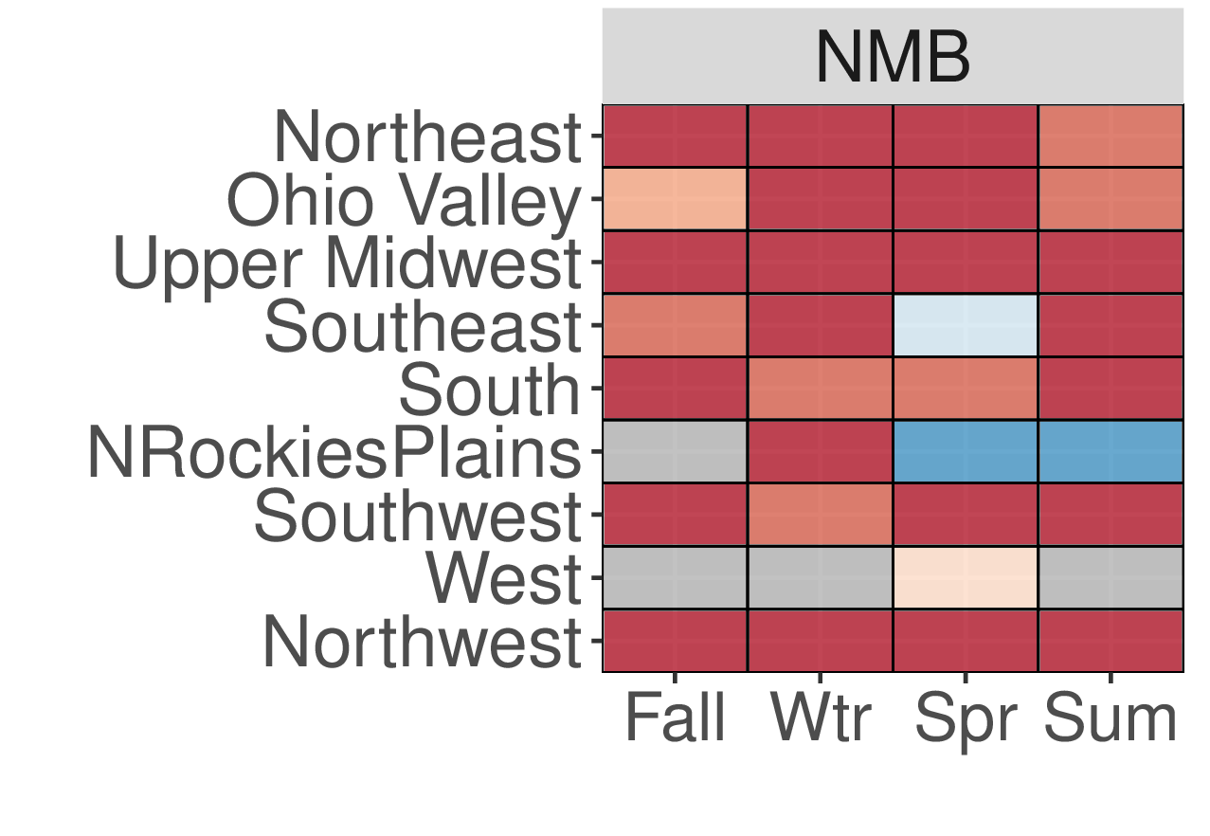
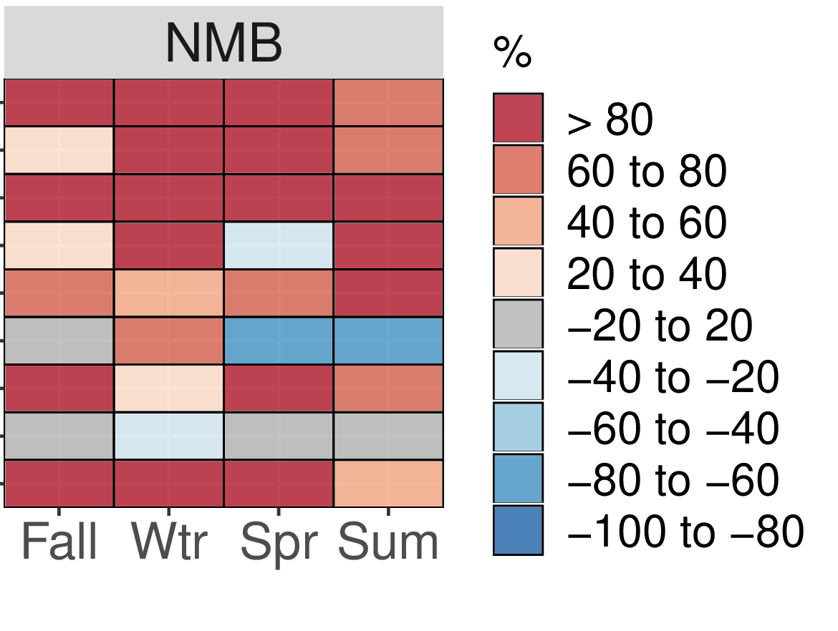
Organic Carbon Bias (%) – Overview
Both models show large overestimates for most regions (except the West) and seasons
Winter underestimates in California (hard to model stable mixing conditions in San Joaquin Valley using 12km resolution modeling)
CMAQ 2016fh
CAMx 2016fh

Slide 18
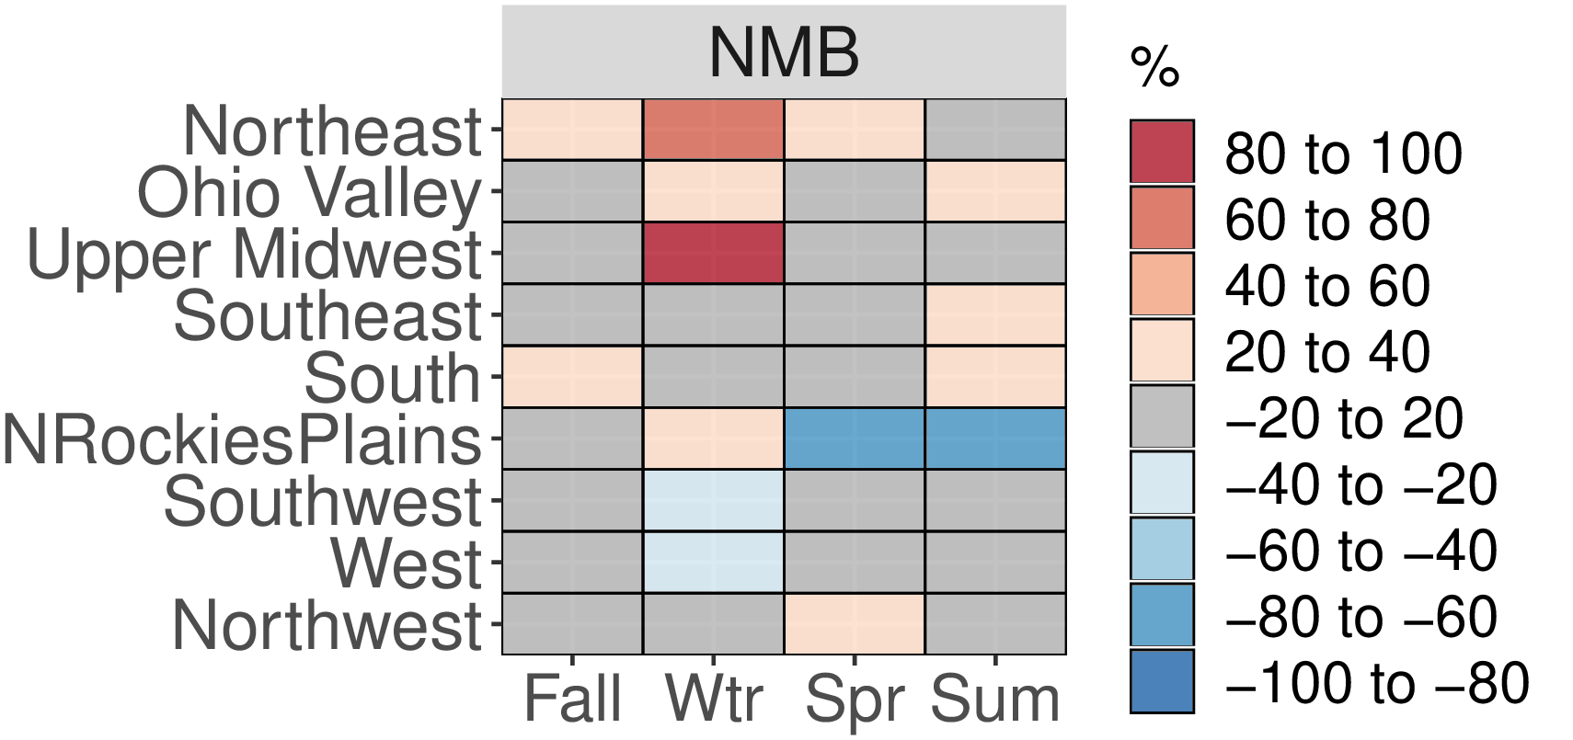
Organic Carbon Recent Science Updates
OAQPS has traditionally run CMAQ using non-volatile POA and no pcSOA
CMAQ developers in EPA Office of Research and Development have been working on numerous science updates for modeling organic carbon
They report less overpredictions in OC using their most up-to-date treatment
CMAQ 2016fh - OAQPS
CMAQ 2016fh - ORD

Slide 19
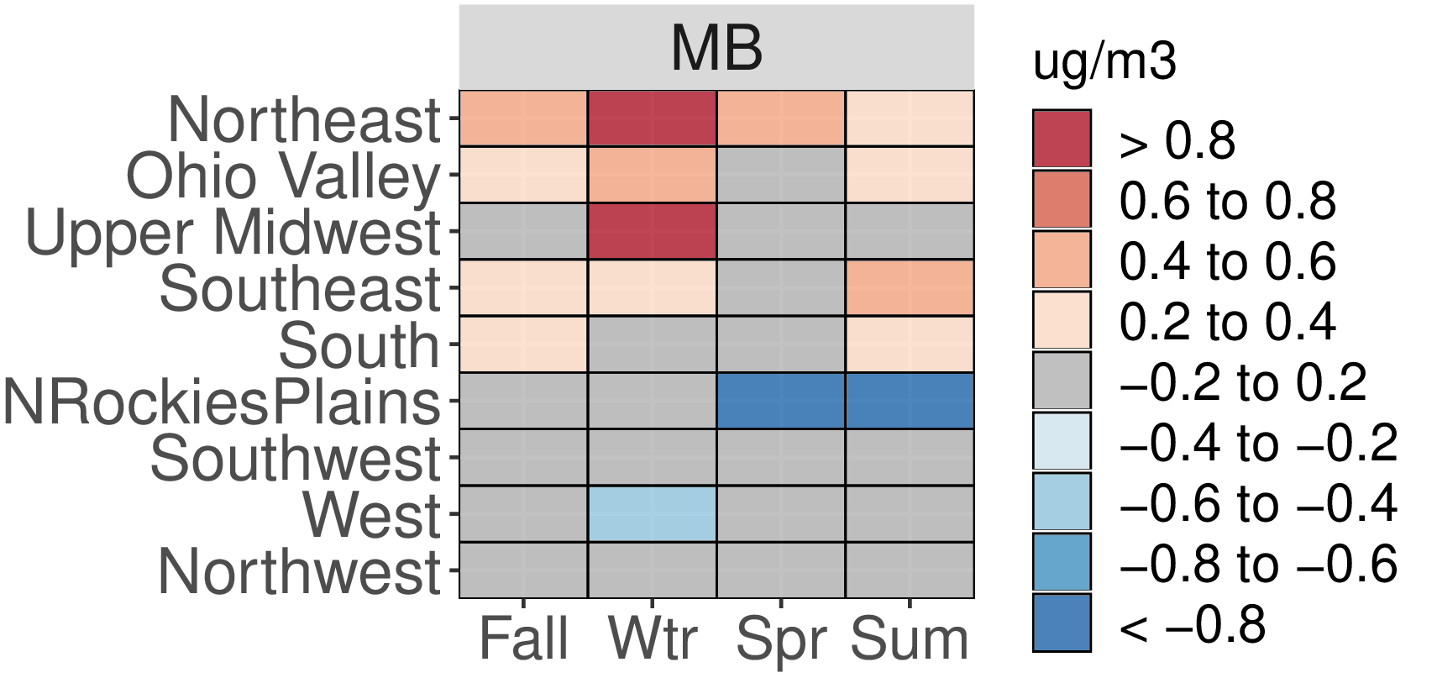
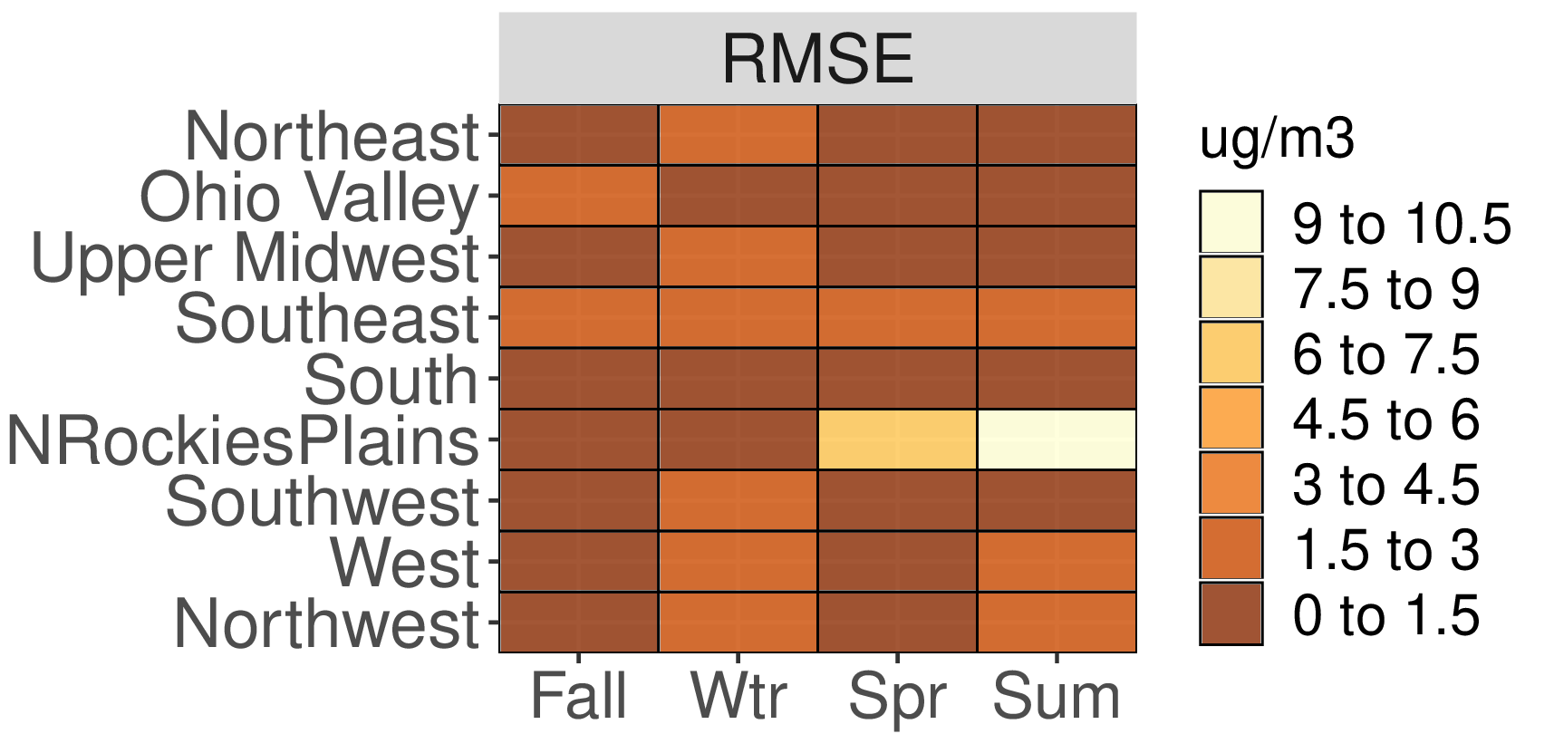
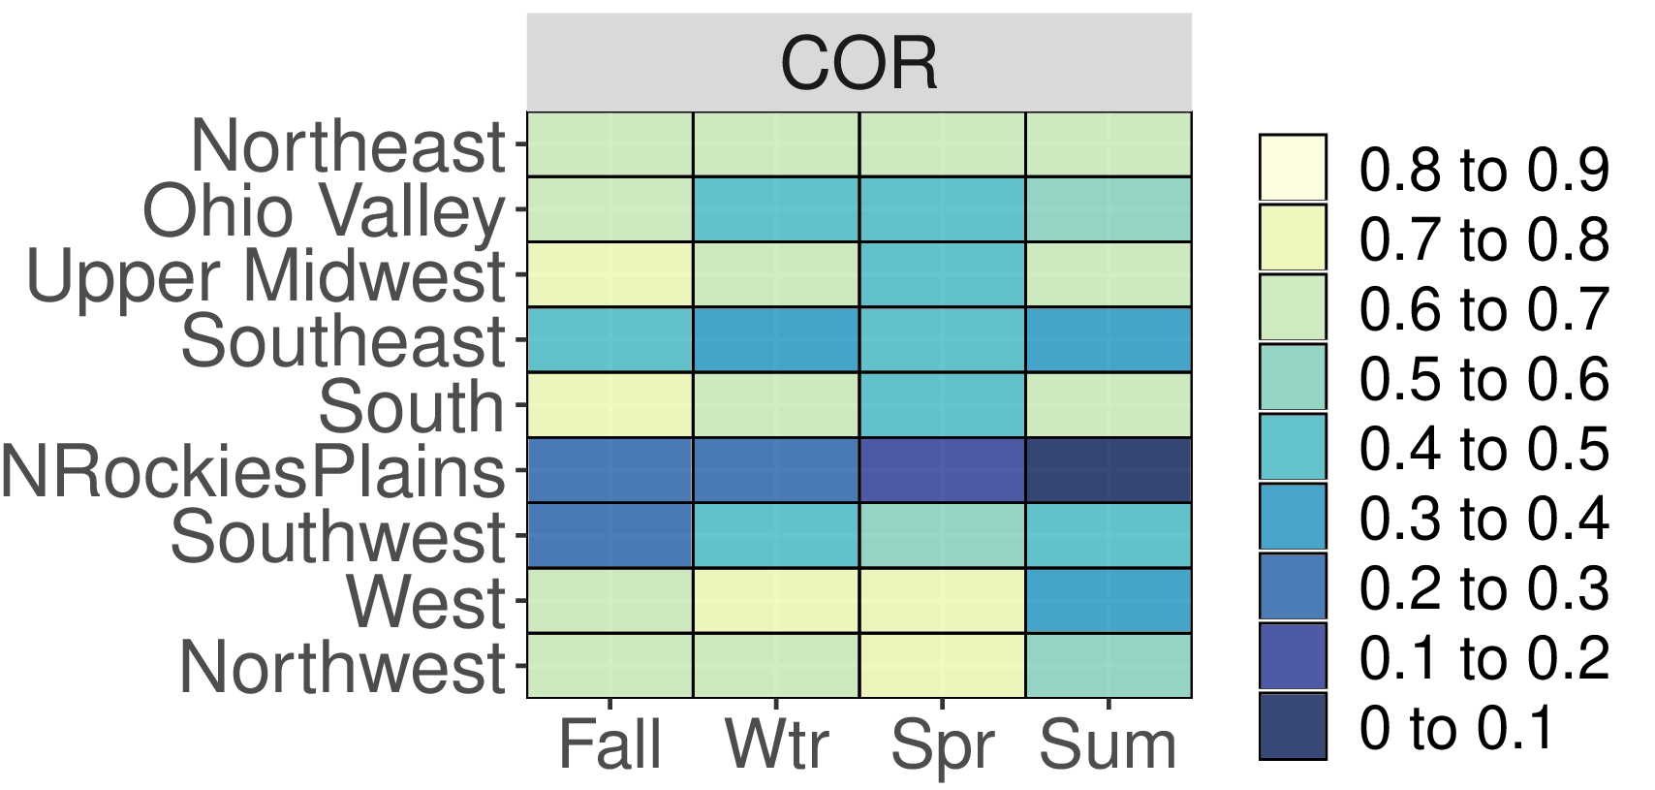
CMAQv531 Categorical OC Performance
OC overestimated in the Northeast, Ohio Valley and Upper Midwest in winter

Slide 20
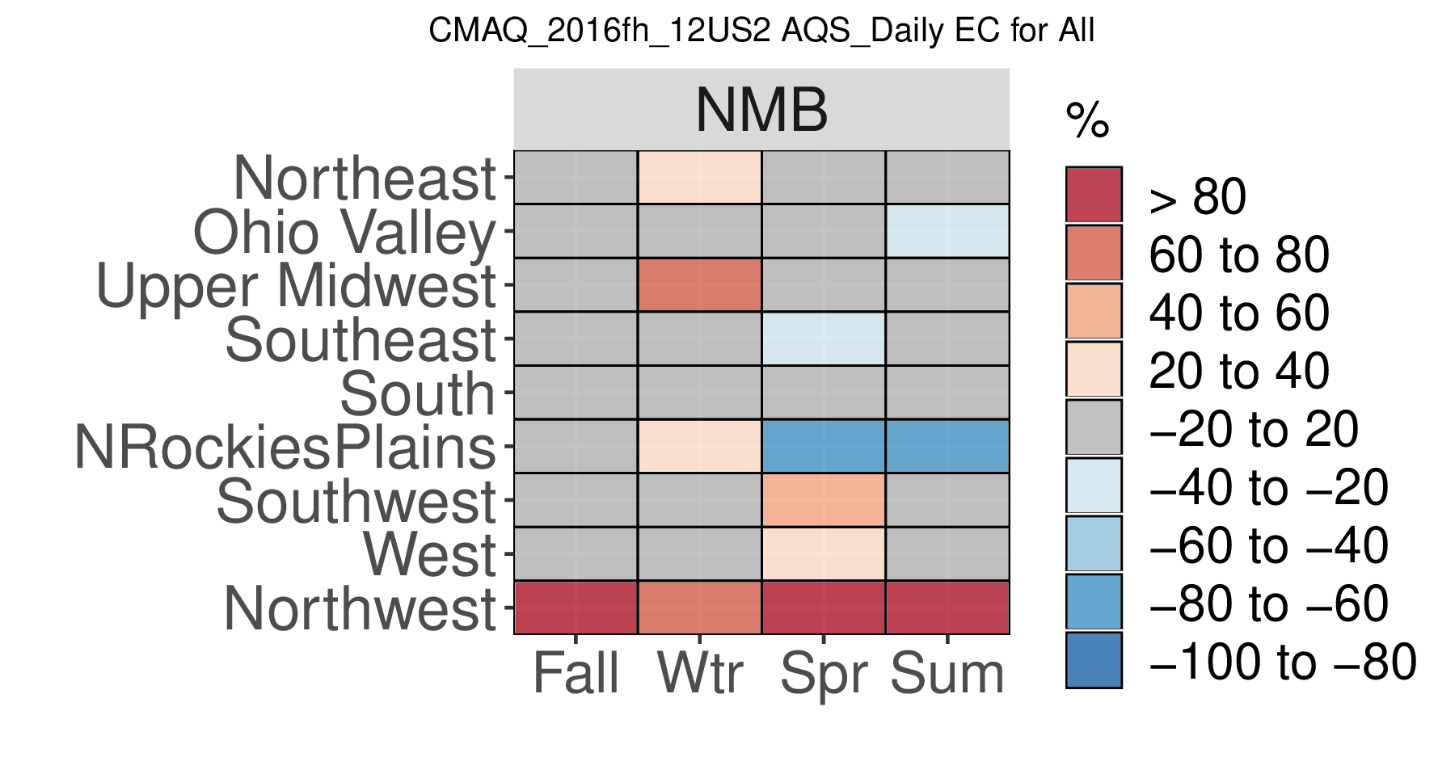
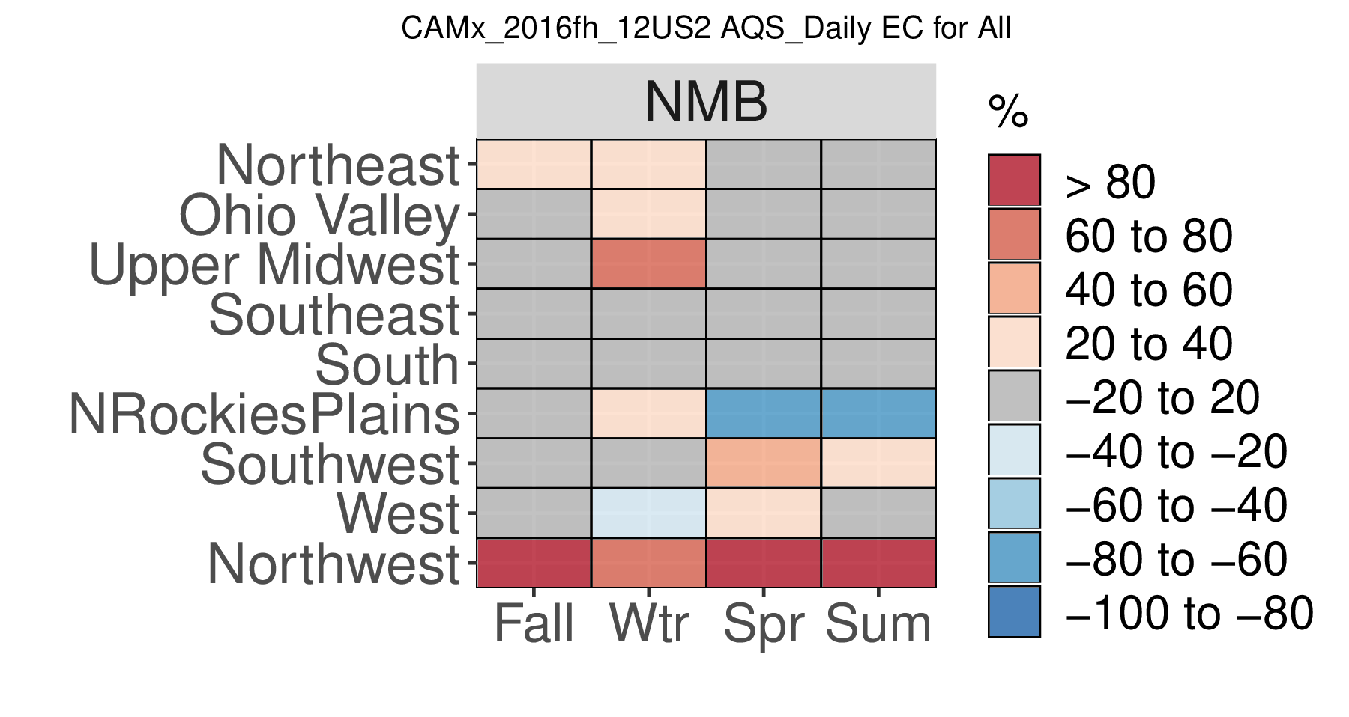
EC Bias (%) – Overview
EC performance has improved since 2015, likely related in part to fire speciation updates
CMAQ 2016fh
CAMx 2016fh

Slide 21
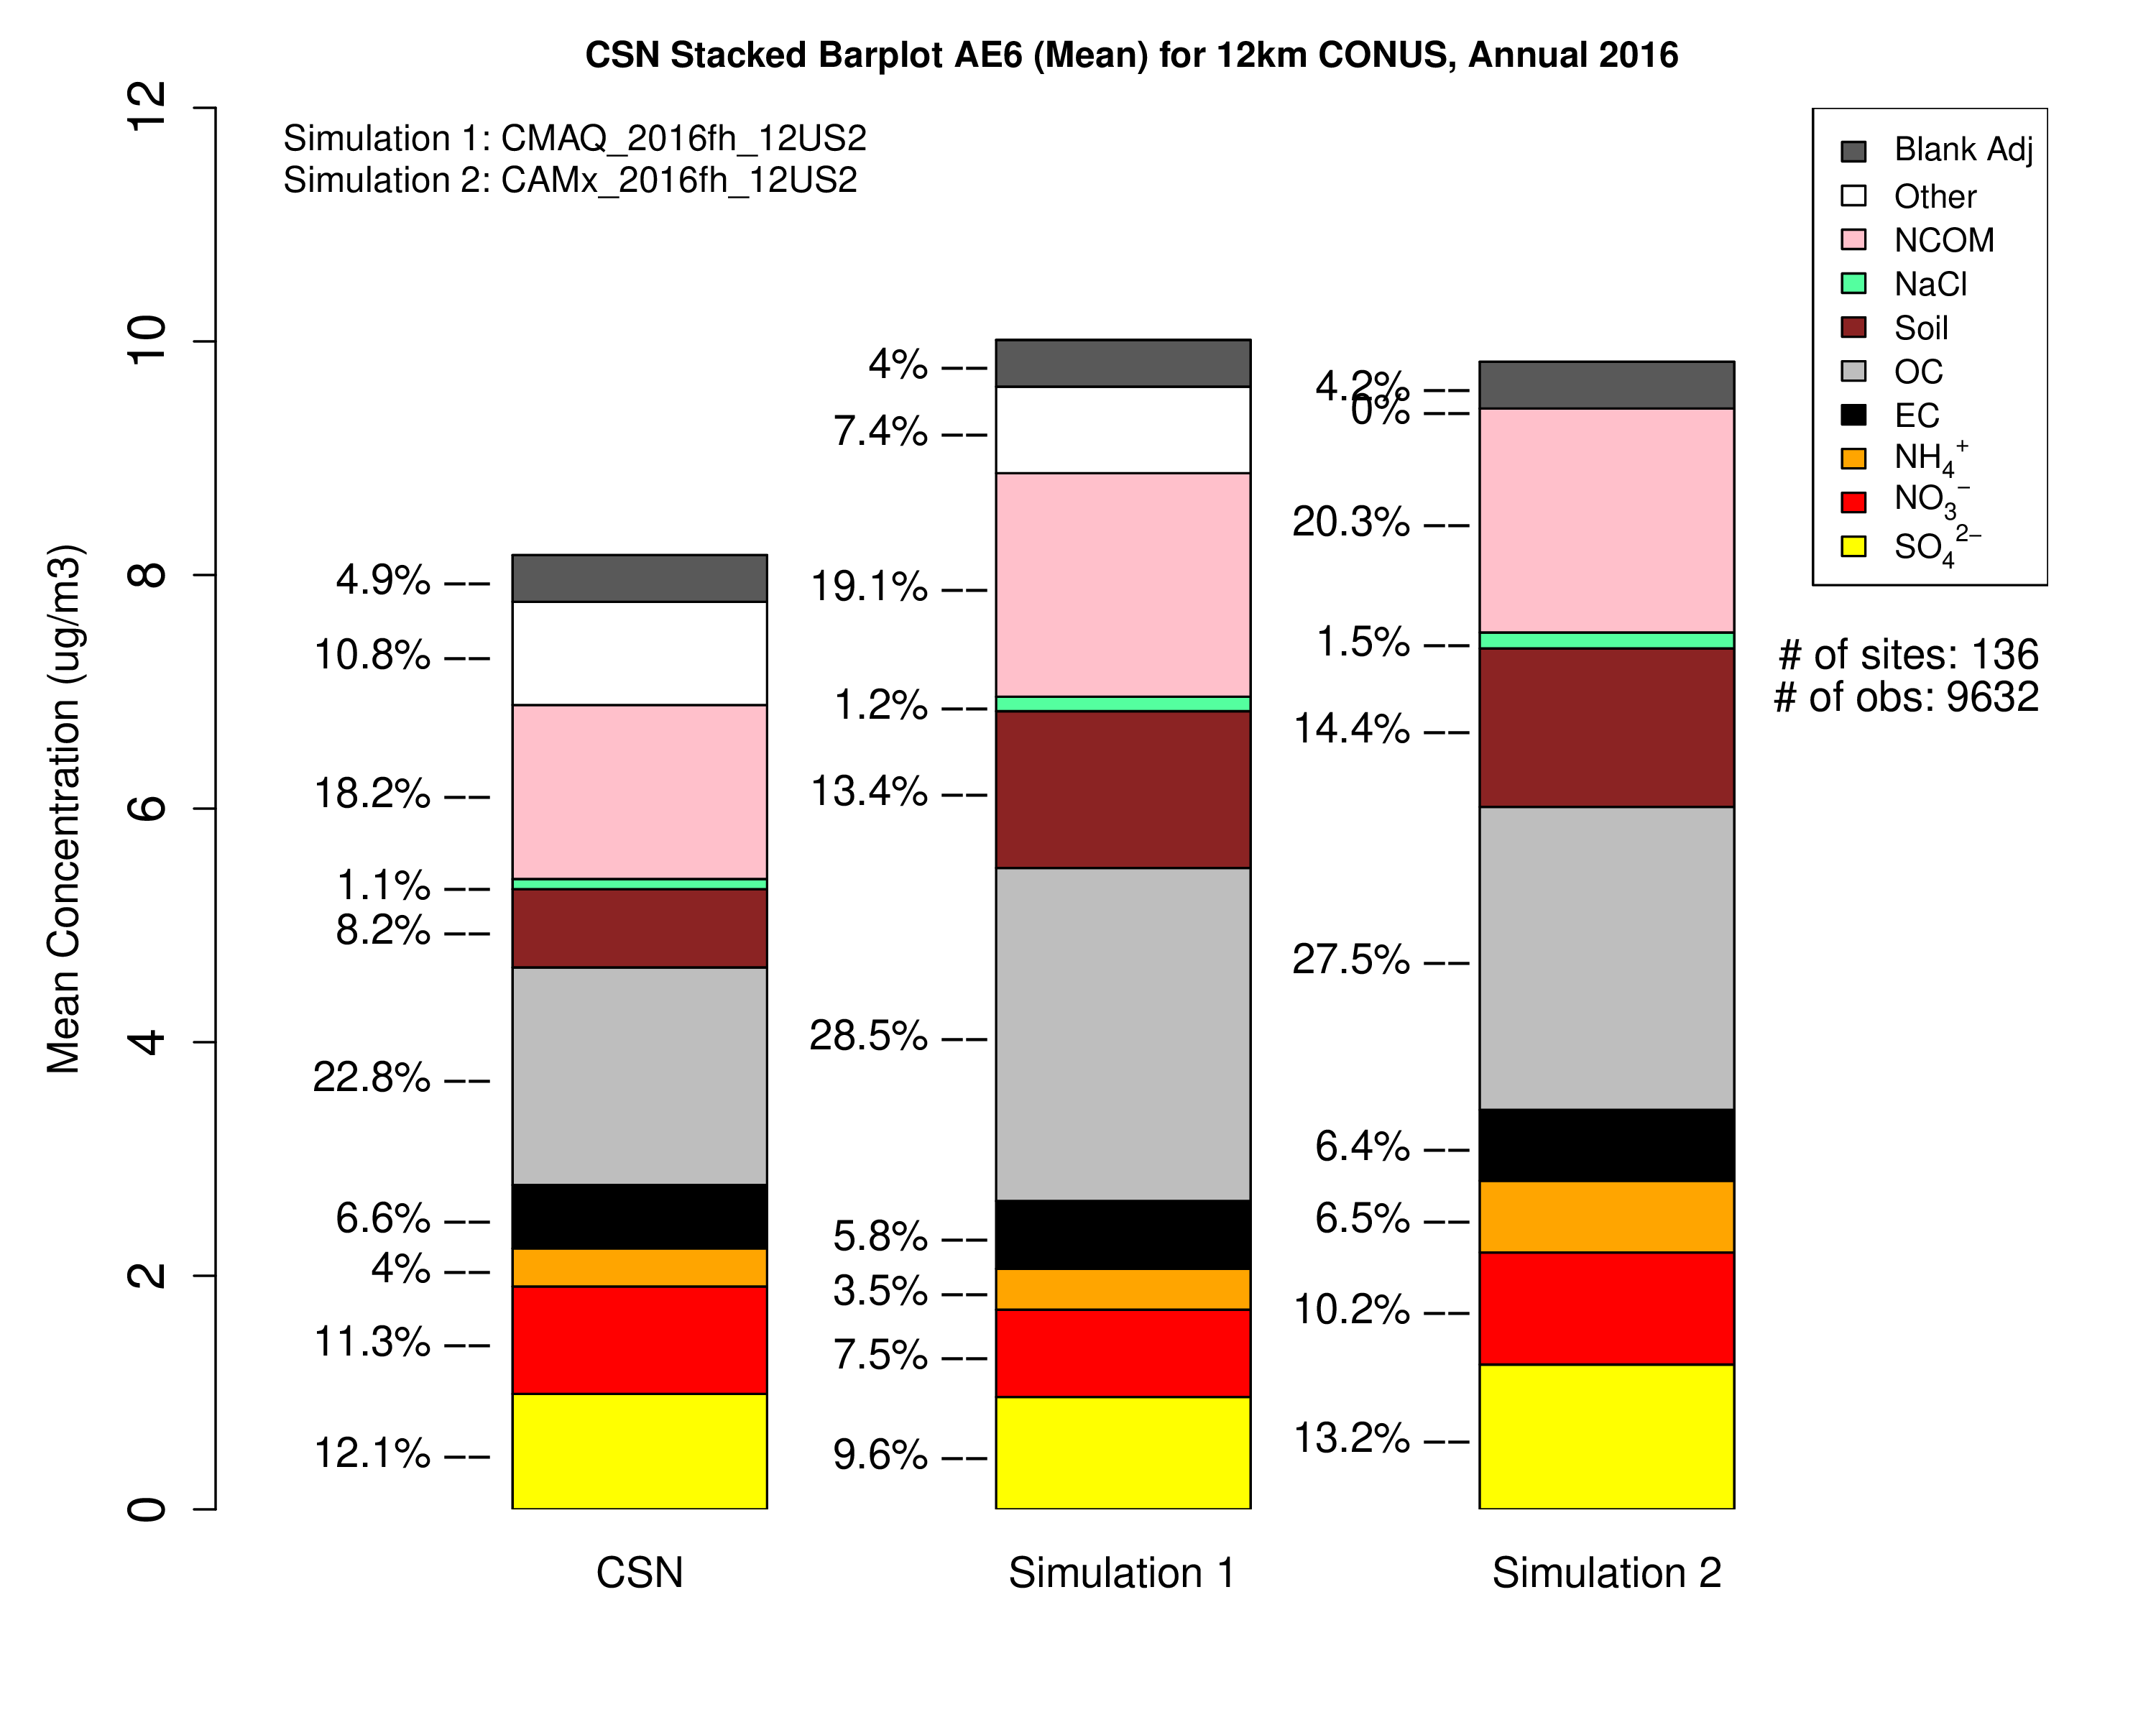
PM2.5 performance key takeaways
Sulfate
CAMx:
bias is mostly between -20% and +40% in winter/Eastern US
bias is between -20% and +20% in summer/Ohio River Valley
CMAQ:
underpredictions are generally less than -20% in winter/Eastern US
bias is between -40% and -20% in summer/Ohio River Valley
Nitrate:
CMAQ
Winter Midwest shows underpredictions up to 20%, Northeast corridor shows overpredictions, underpredictions in SW
Spring underpredictions across entire US
Using STAGE and M3DRY bi-direction ammonia flux improve performance
CAMx
Winter Midwest shows underpredictions up to 20%, Northeast corridor shows overpredictions, underpredictions in SW
Spring CAMx bias is between -20% and + 20%
Both models: Underestimates in California at 12km resolution
OC overestimates across all regions/seasons in both models
More investigation needed
Underestimates in California at 12km resolution
EC performance generally shows bias withing +/-20% in most regions/season
Annual CONUS CSN PM2.5
CSN
CMAQ
CAMx

Slide 22
Ozone

Slide 23
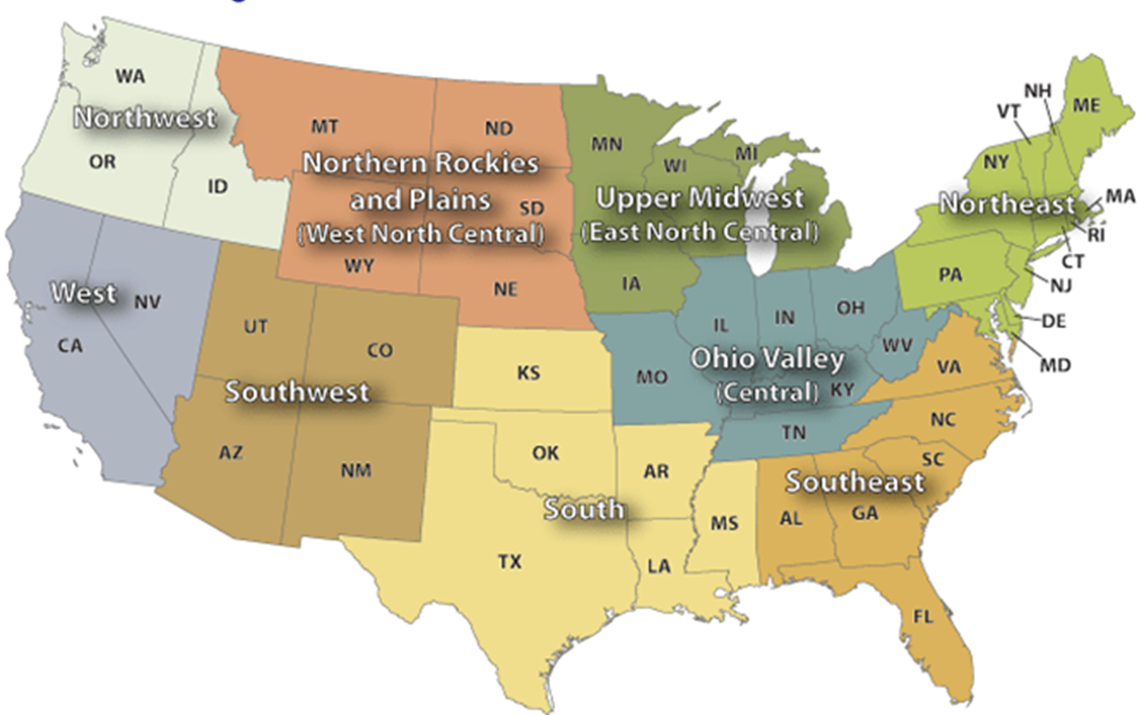
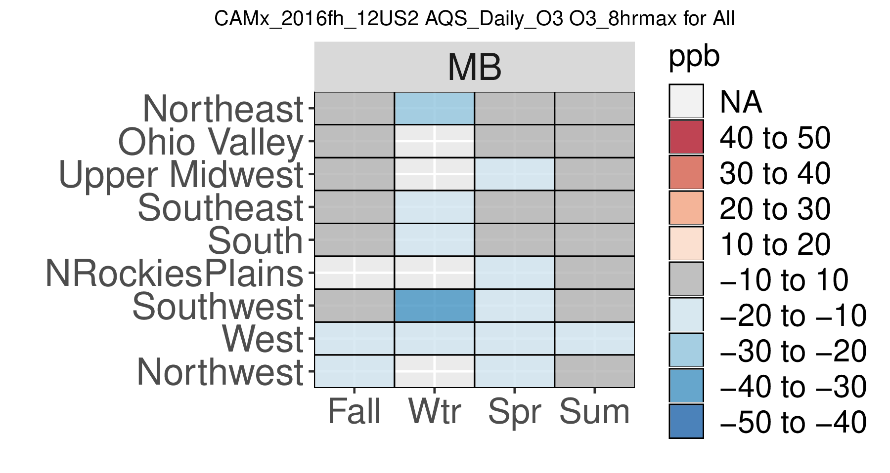
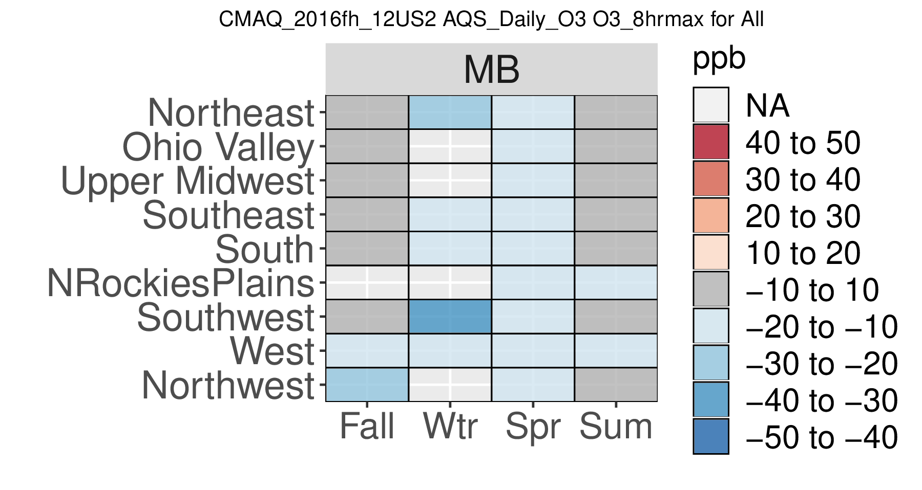
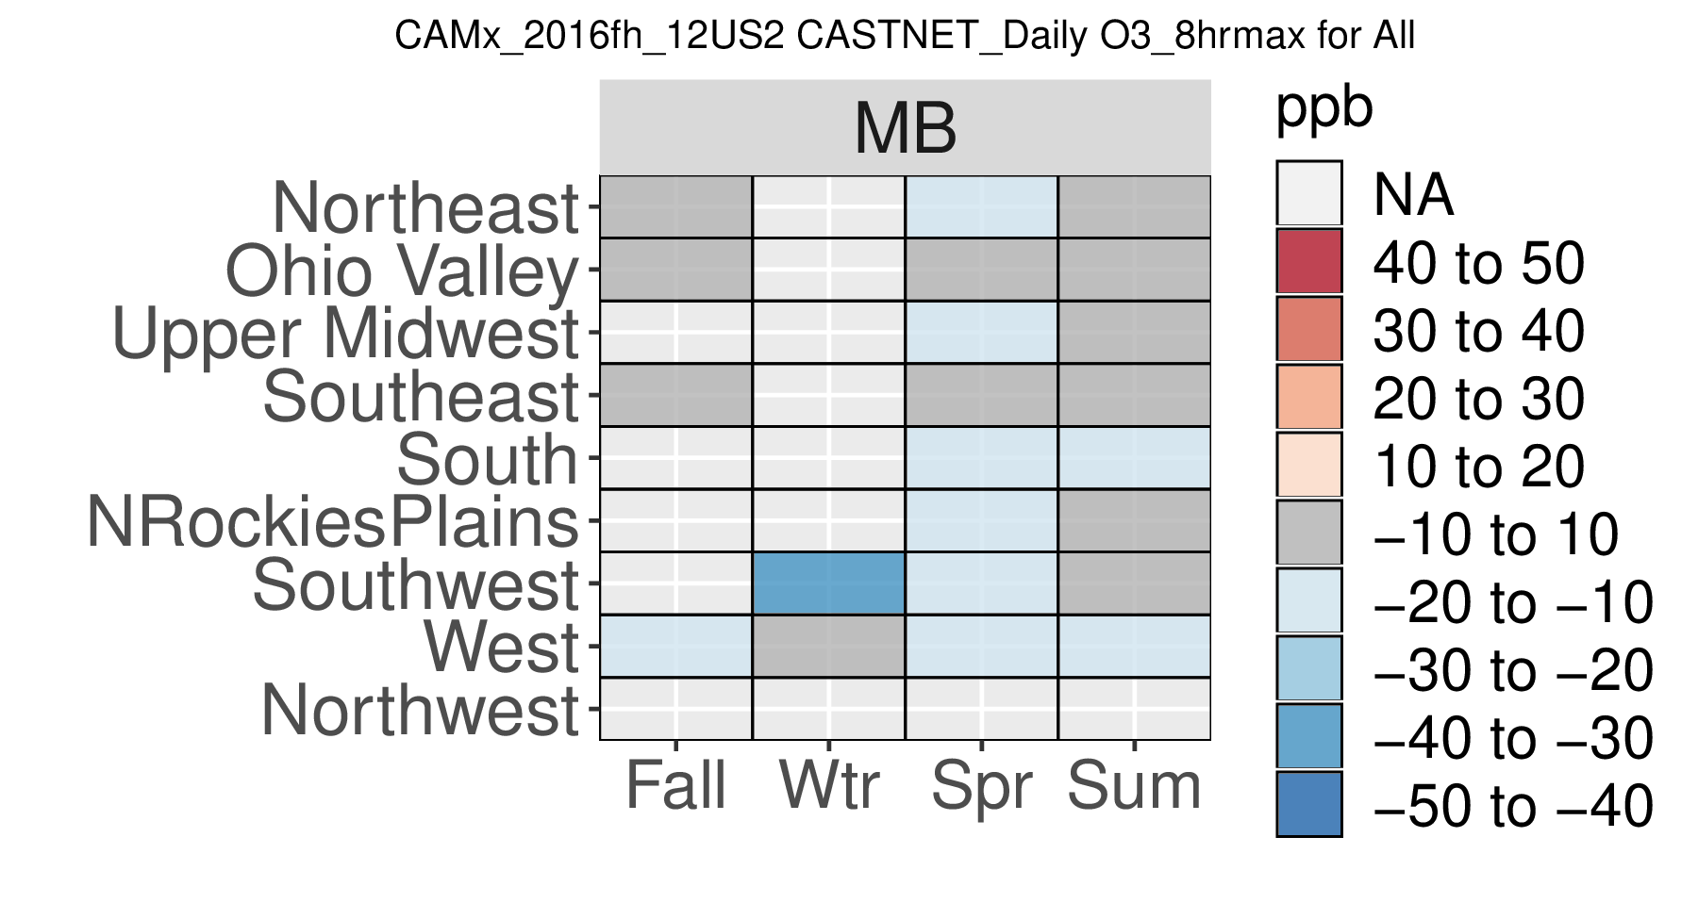
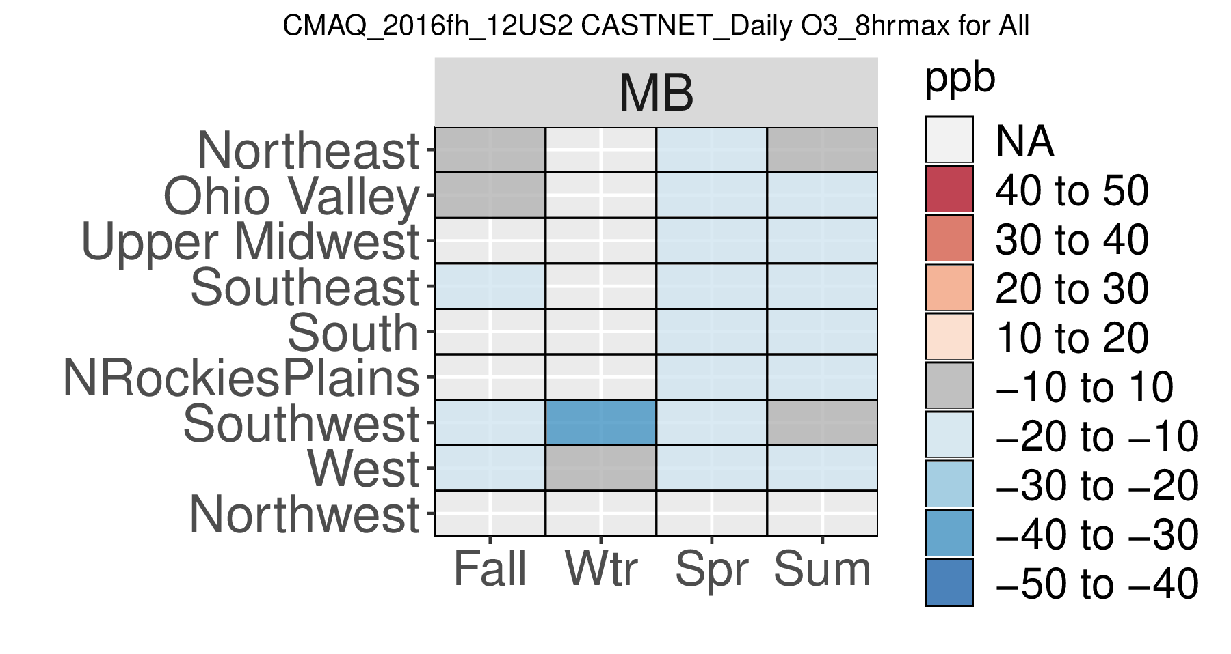
Region/Season Mean Bias
MDA8 > 60 ppb
CAMx
CMAQ
<= AQS =>
Sites
<= CASTNet =>
Sites
Notes:
Spring - AQS
CAMx: MB is generally underpredicted in the range of 10 to 20 ppb in the Upper Midwest and in the western US regions.
CMAQ: MB is generally underpredicted in the range of 10 to 20 ppb in all regions
Summer – AQS
MB for CAMx and CMAQ is within + 10 ppb in most regions.
Spring/Summer – CASTNet
CMAQ shows under prediction in the range of 10 to 20 ppb in more regions that CAMx.

Slide 24
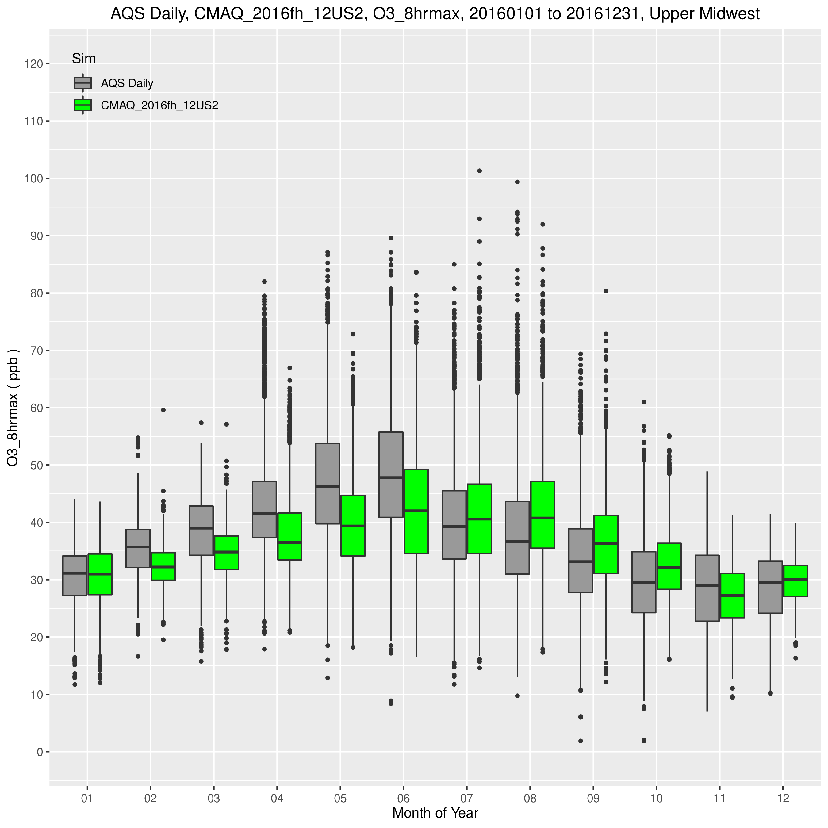
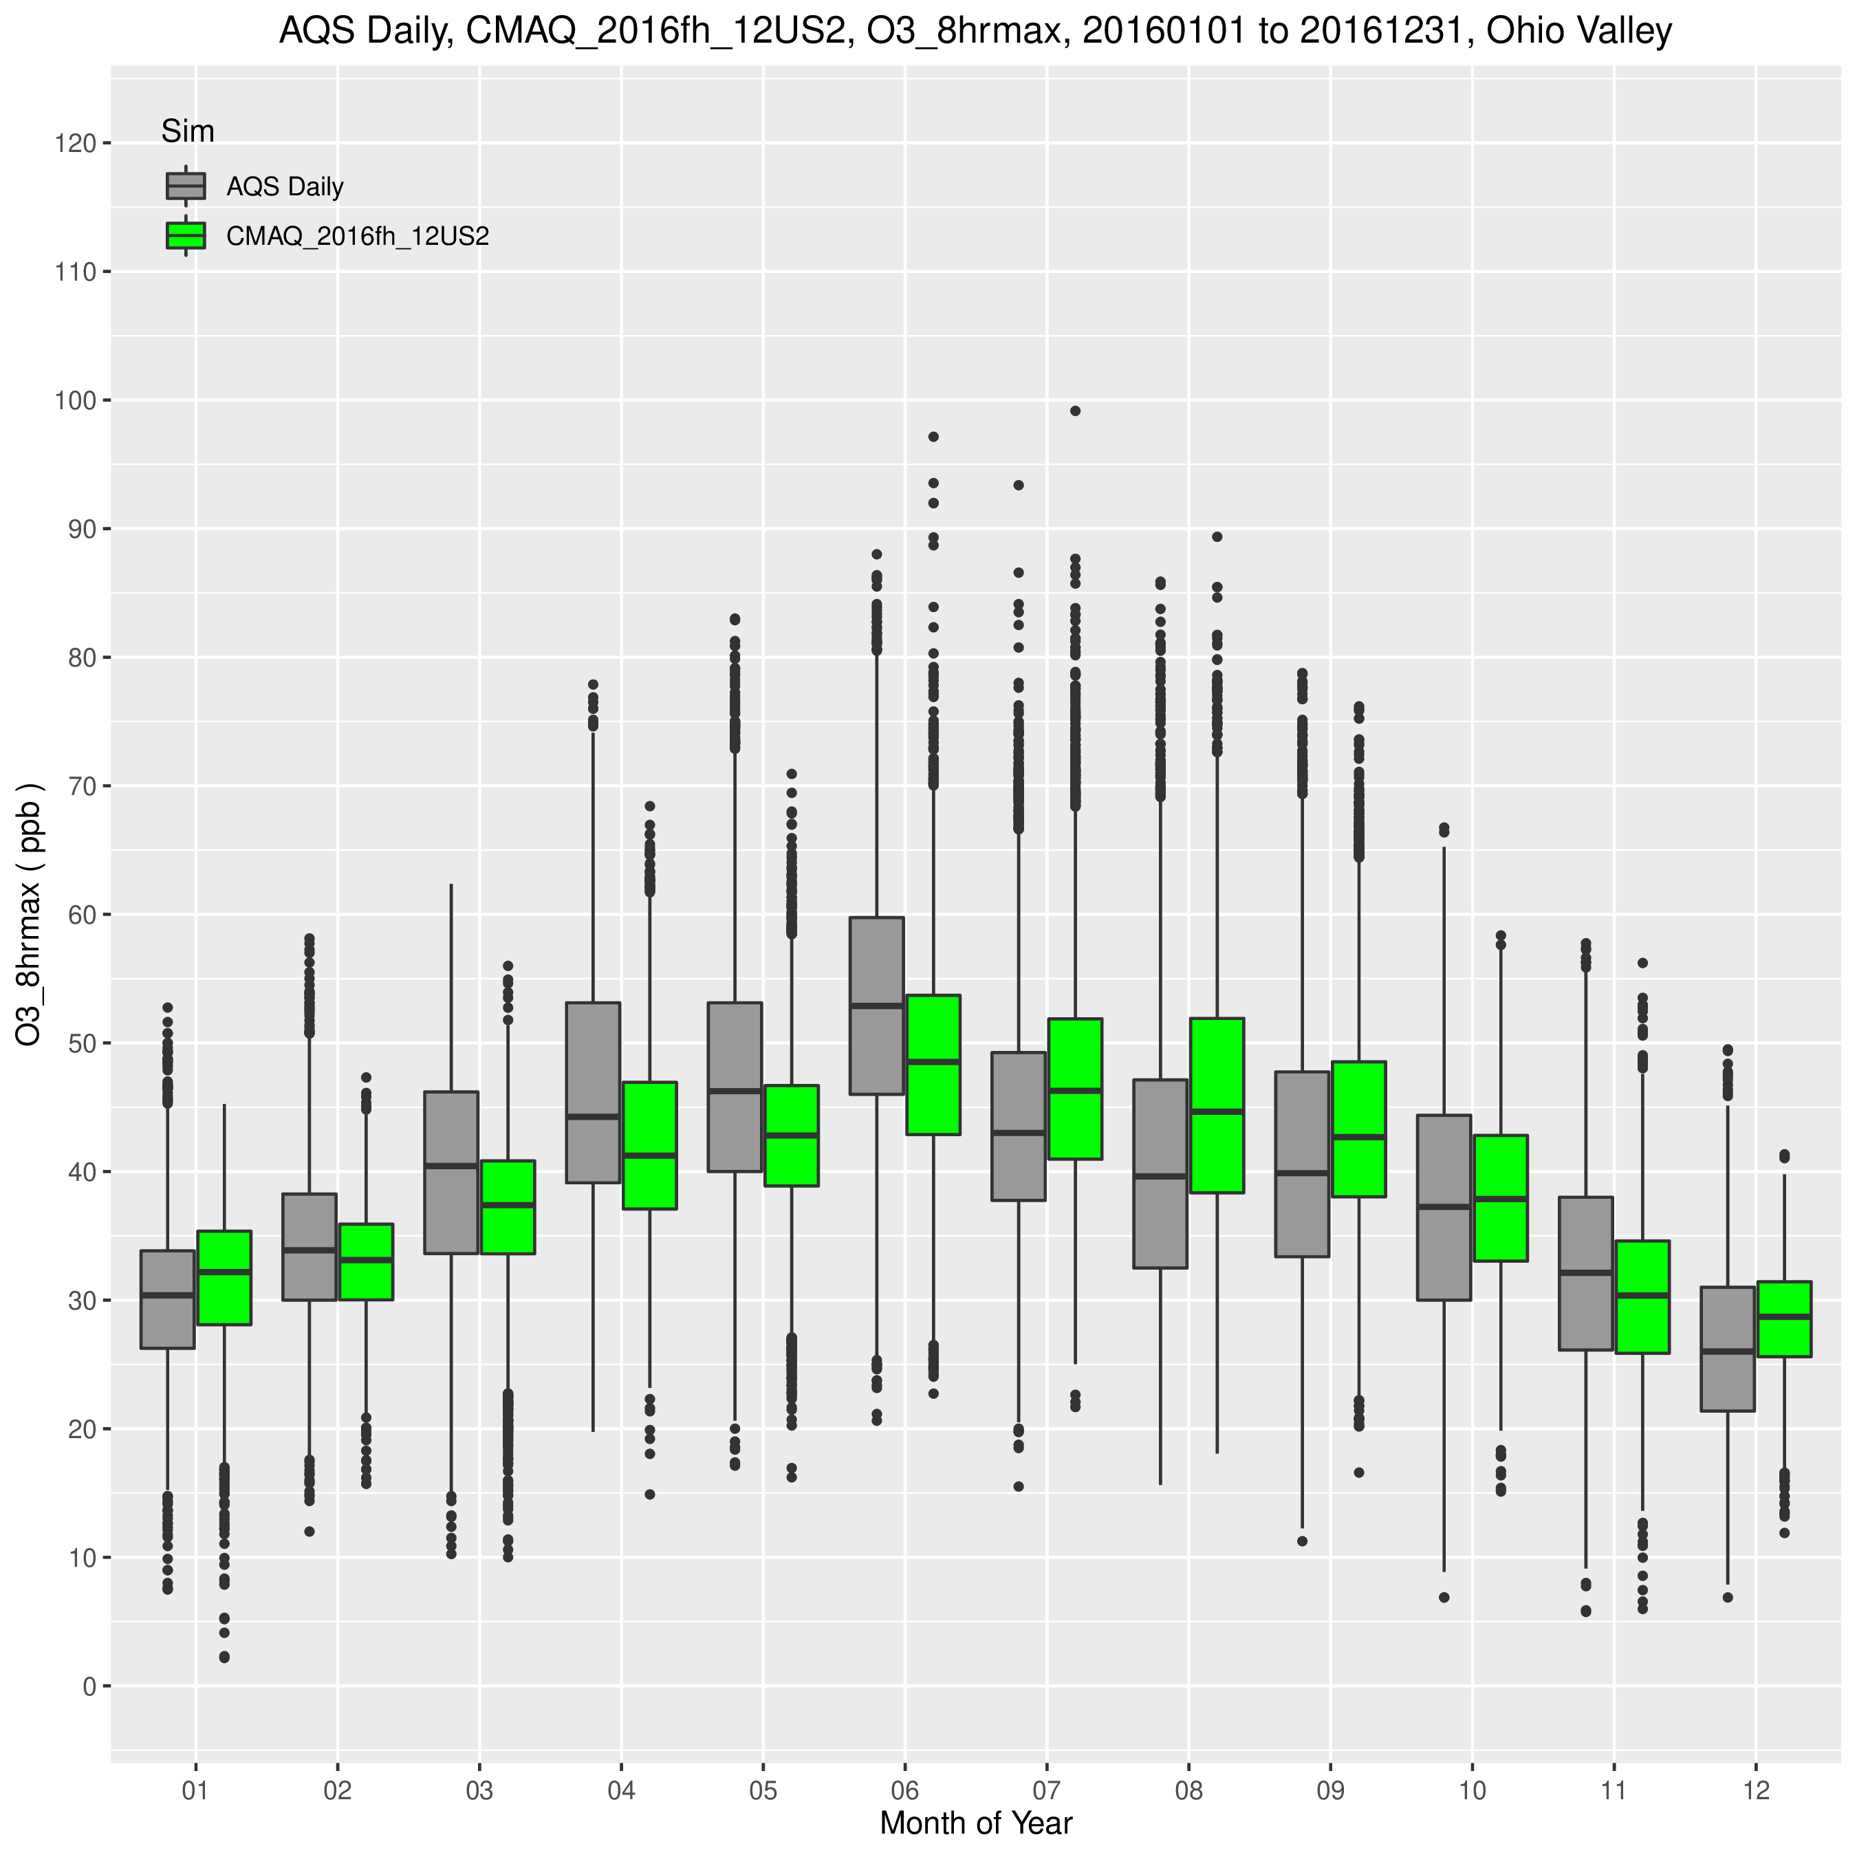
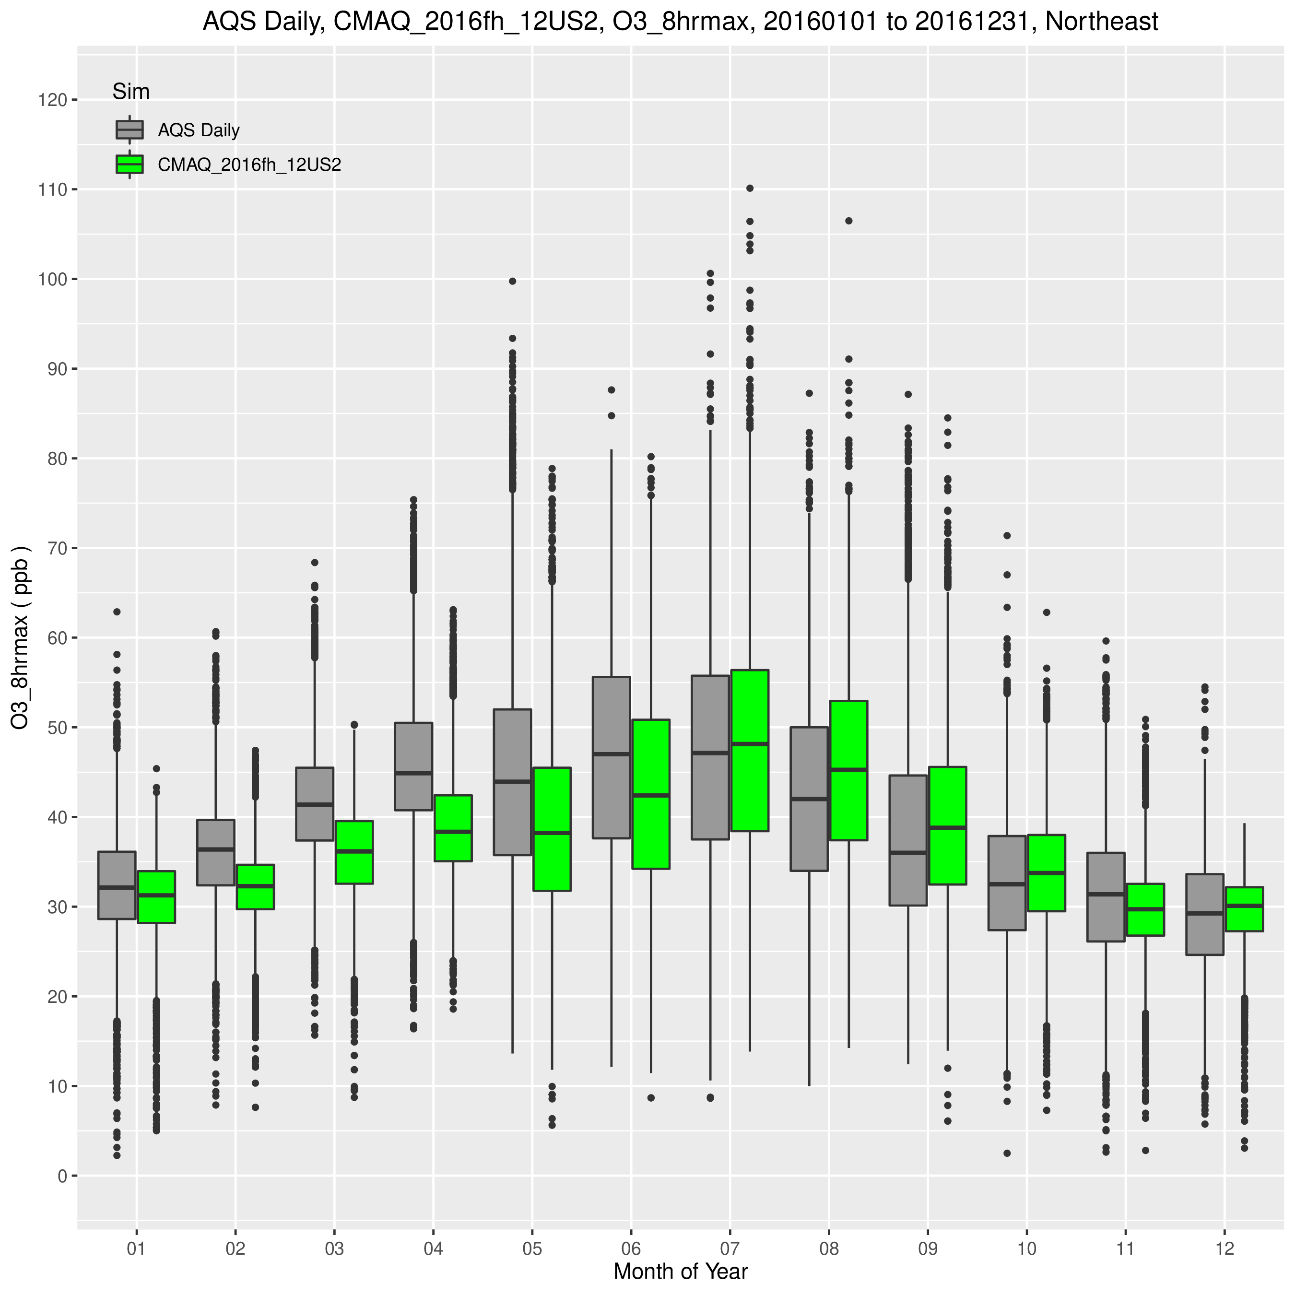
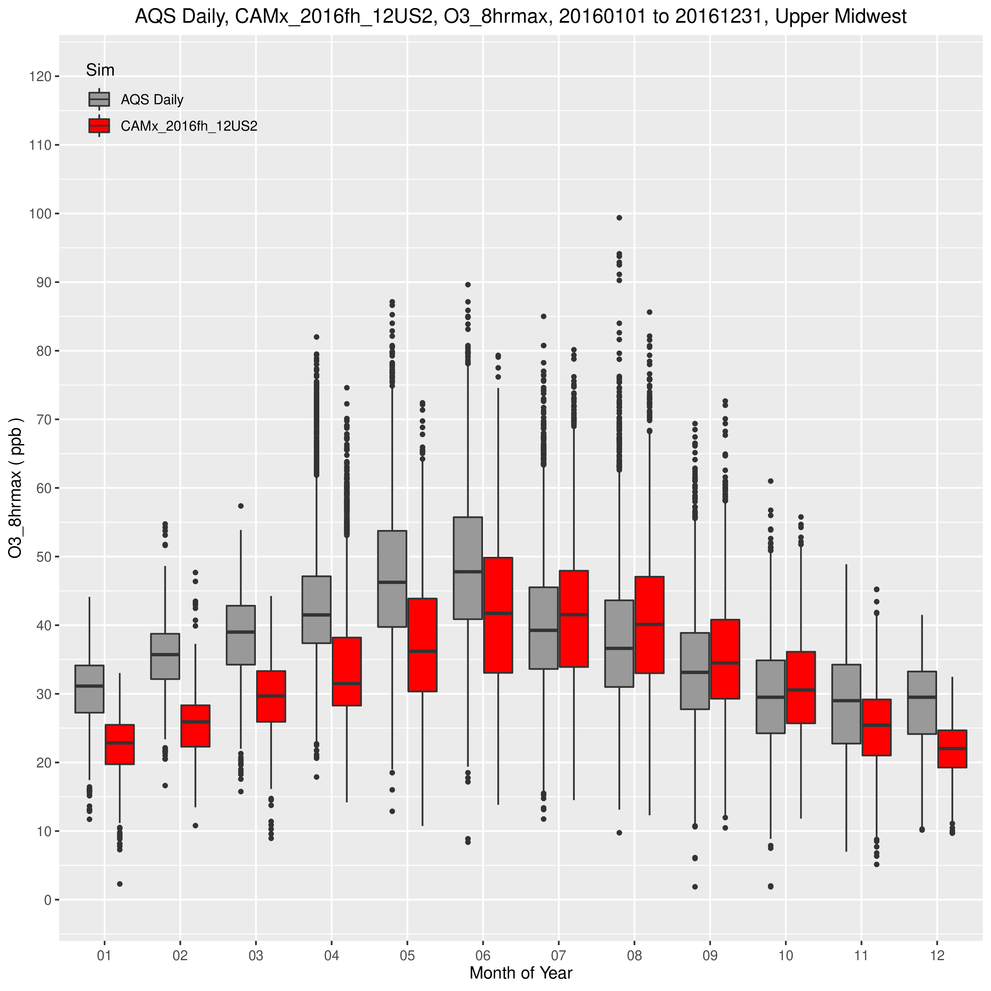
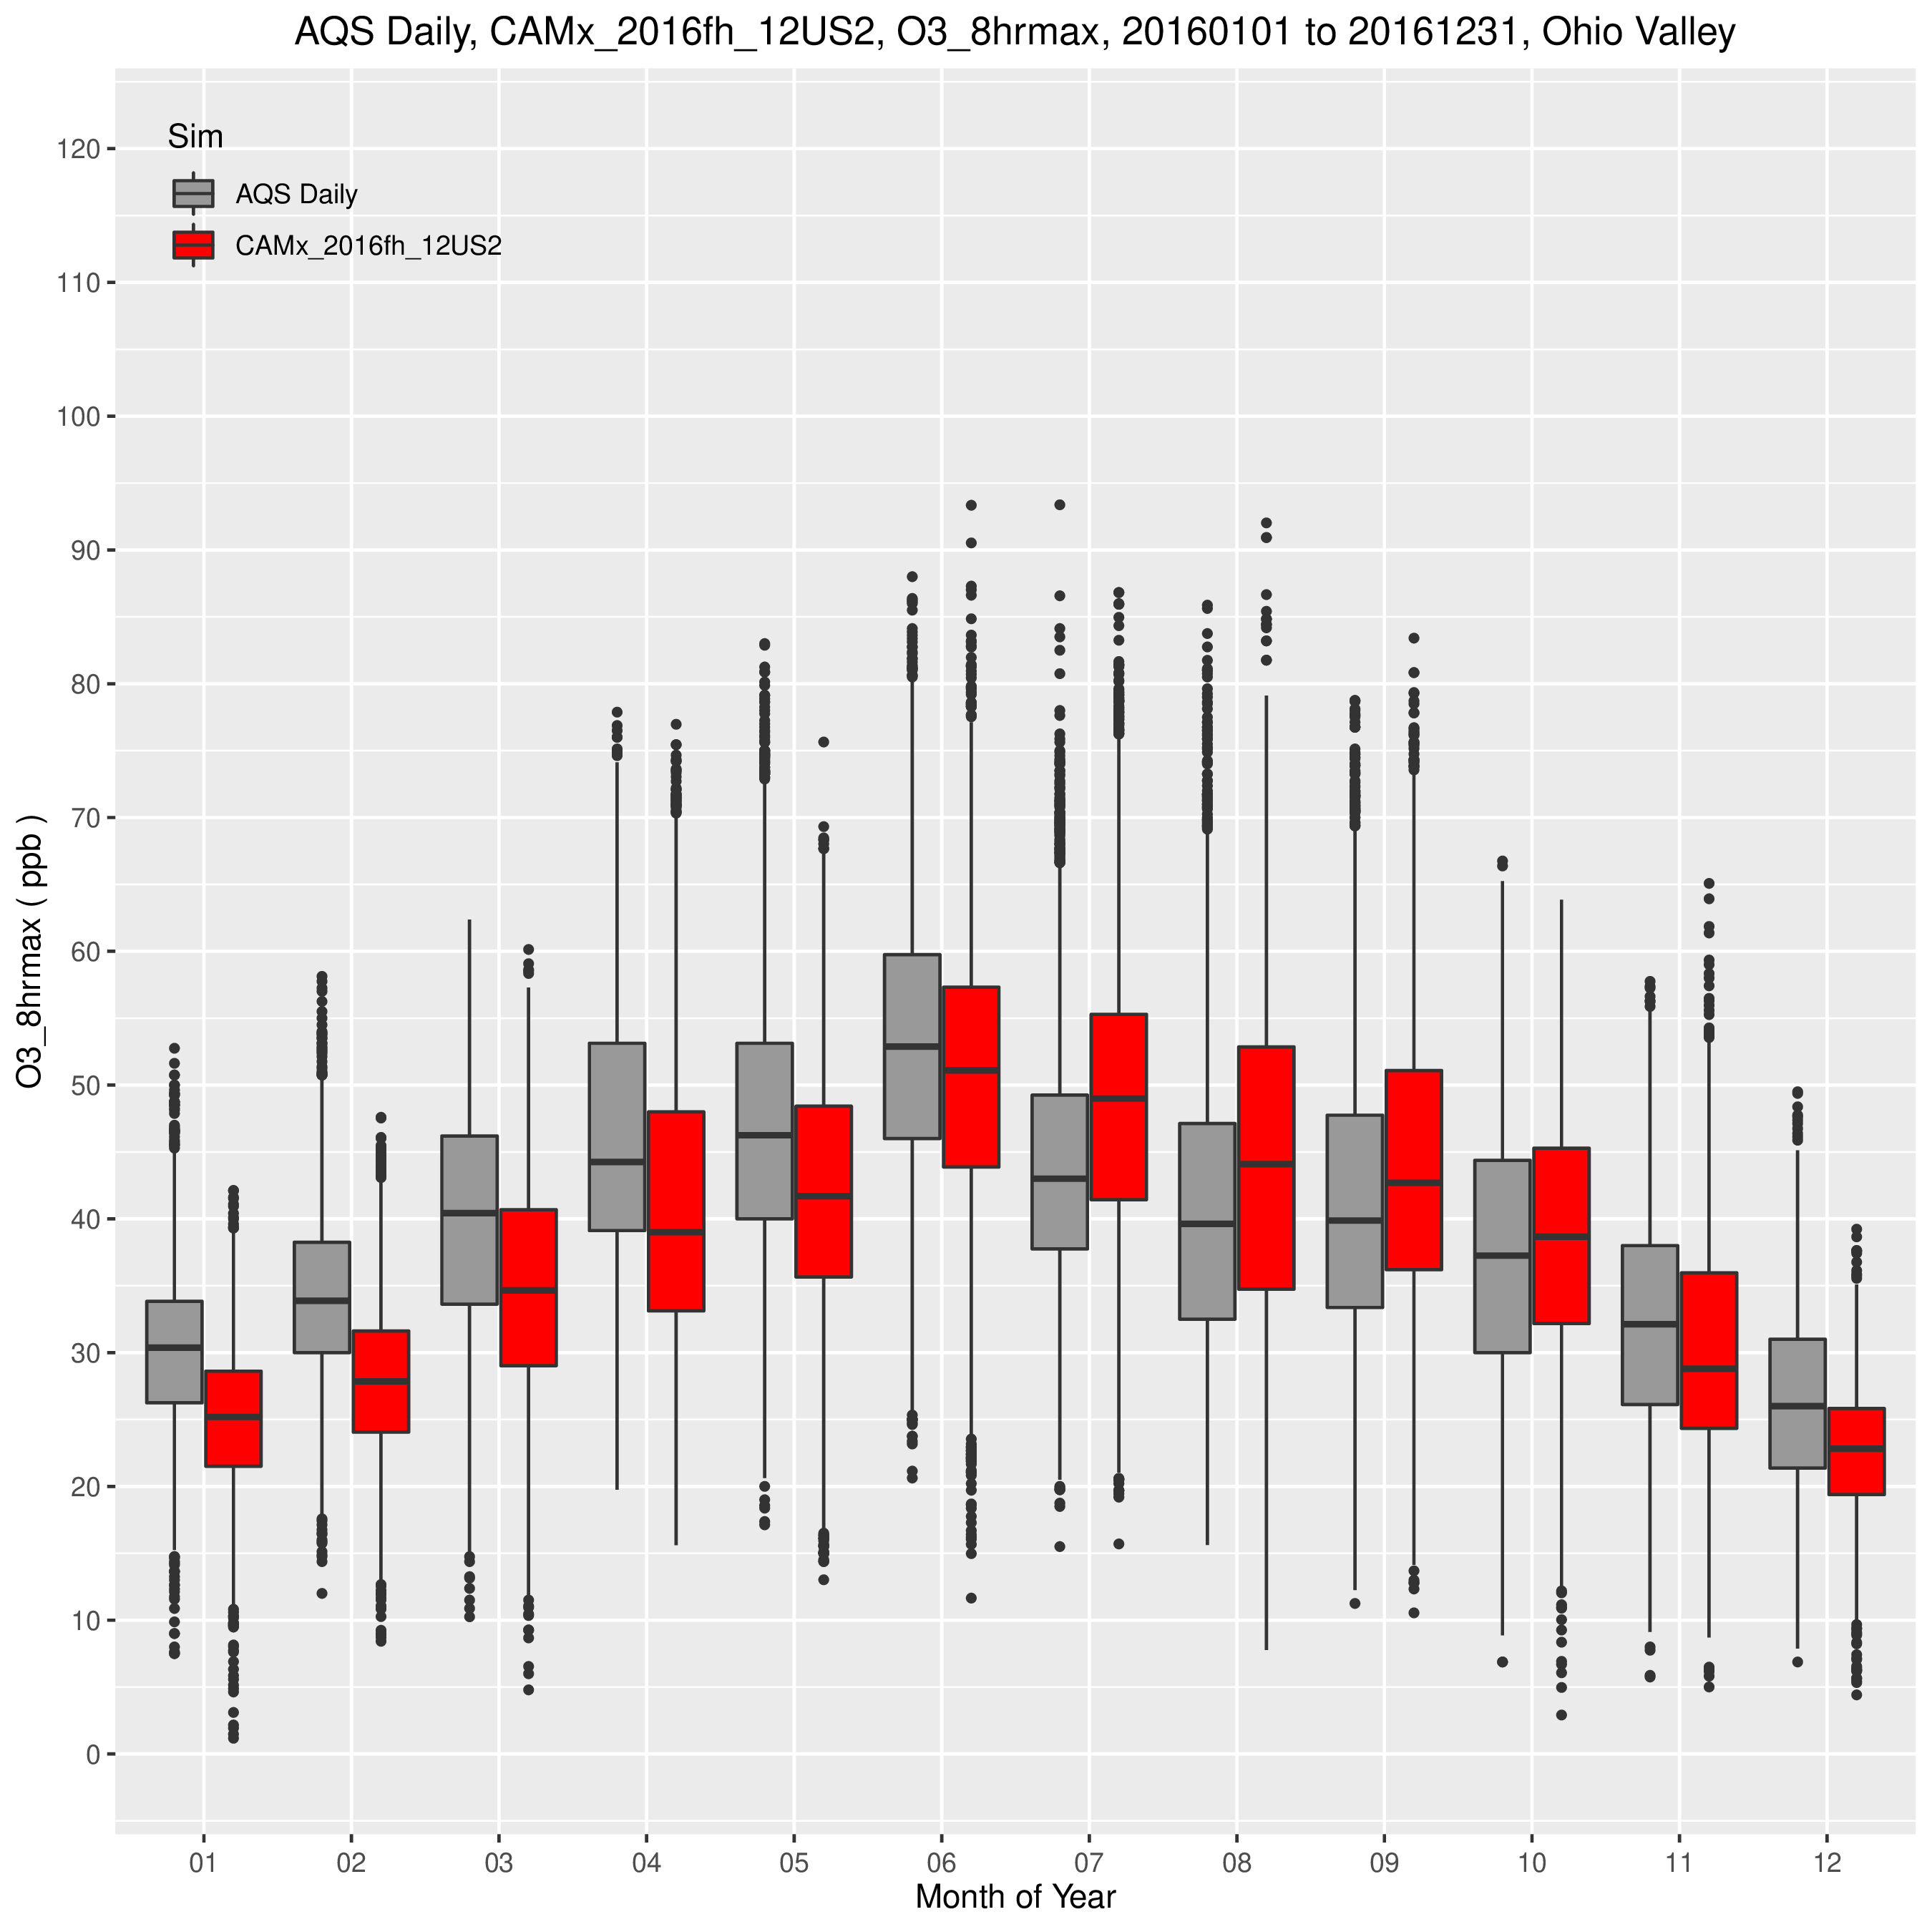
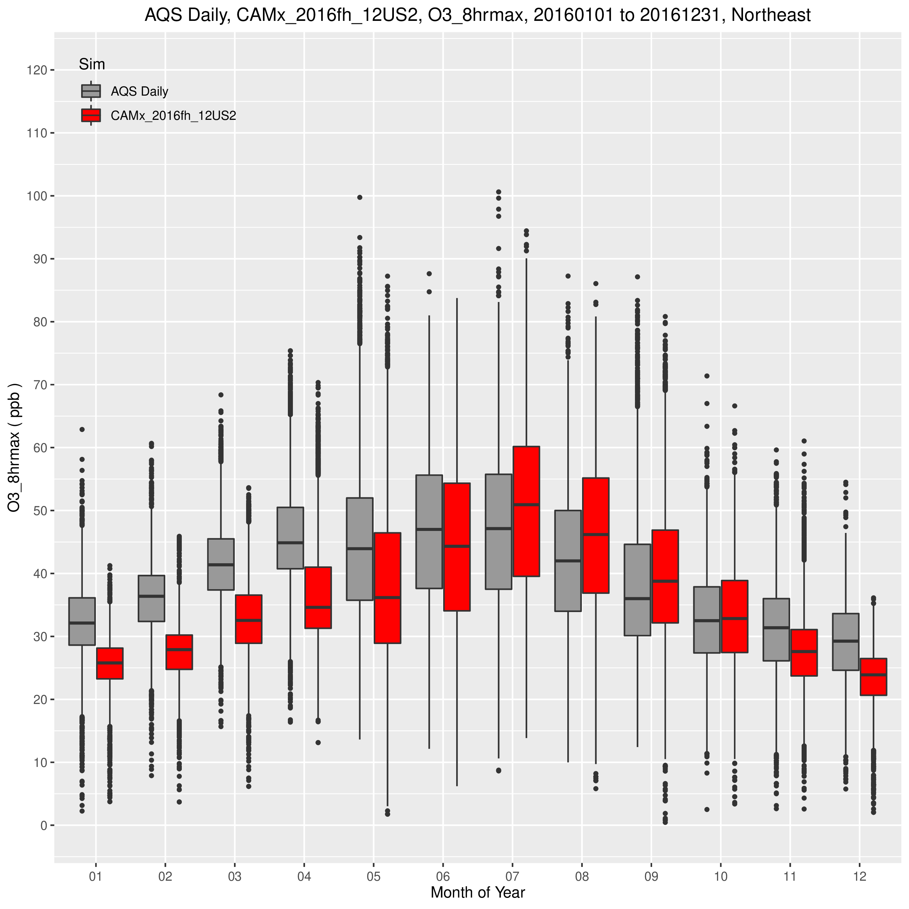
MDA8 O3 Monthly Box Plots by Region
Midwest
Ohio Valley
Northeast
100 ppb
CMAQ =>
20 ppb
100 ppb
CAMx =>
20 ppb
Notes:
Both CAMx and CMAQ under predicted MDA8 O3 during the winter and spring in all three regions. The under prediction is greater with CAMx than CMAQ.
In the Midwest and Ohio Valley, the inter-quartile range of observed values declines notably between April/May/June and July/August/September.
The CAMx and CMAQ predictions also decline beginning in July, but not to the extent of the observed data.
In the Northeast, the observed values peak in July as do the model predictions

Slide 25
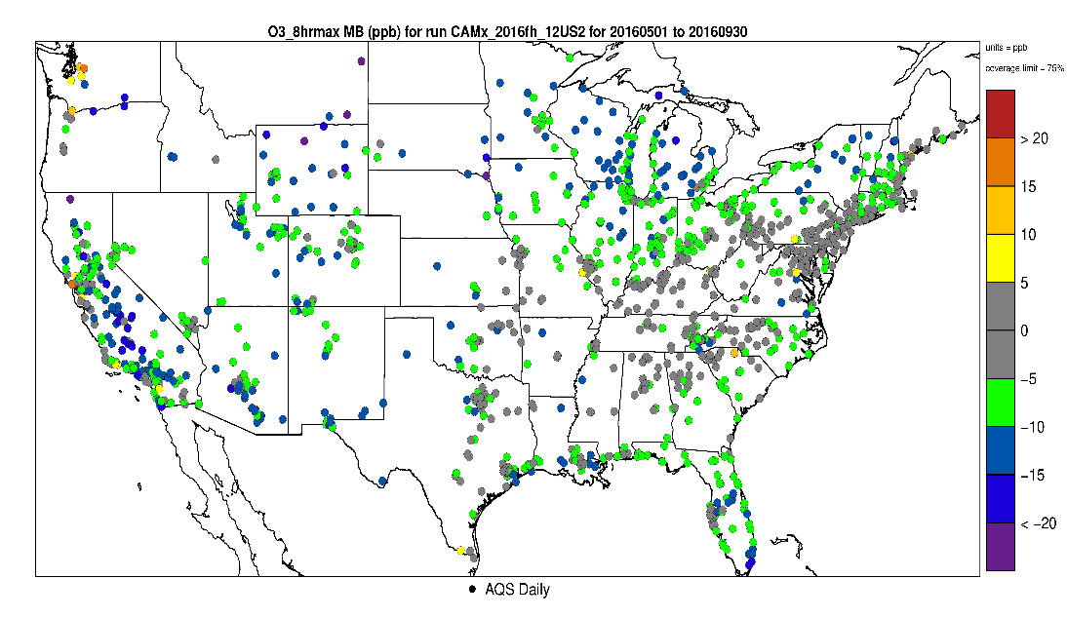
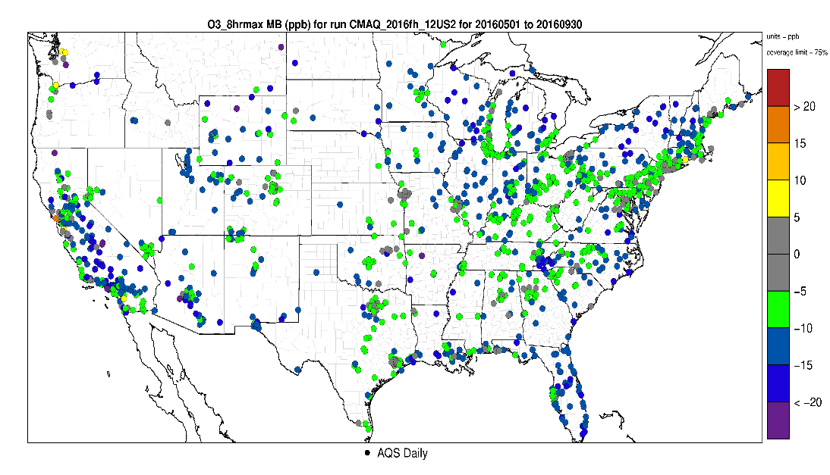
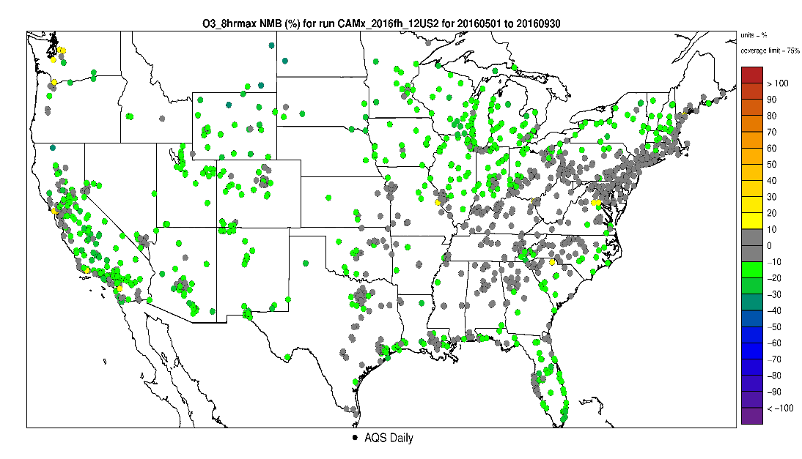
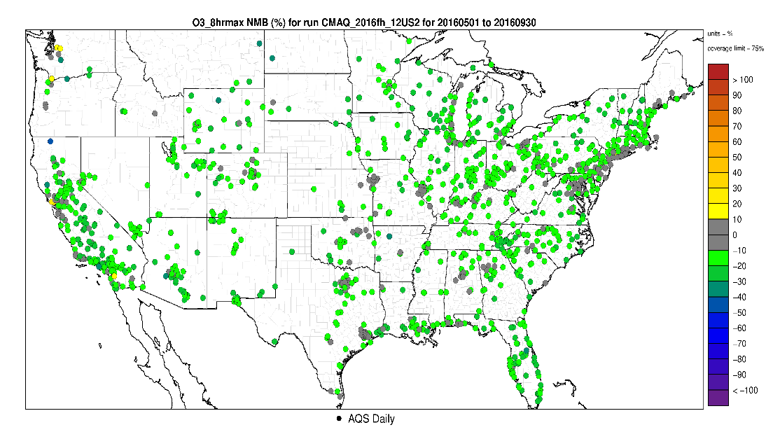
May – September MDA8 O3 > 60 ppb
CAMx
CMAQ
<= Mean =>
Bias
<= Normalized =>
Mean
Bias
Notes:
Most notable difference in performance between the two models is that CAMx shows less under prediction bias in the area from Texas northeastward across the south and Ohio Valley, up to and along the NE Corridor.
Elsewhere both models tend to show similar performance.

Slide 26
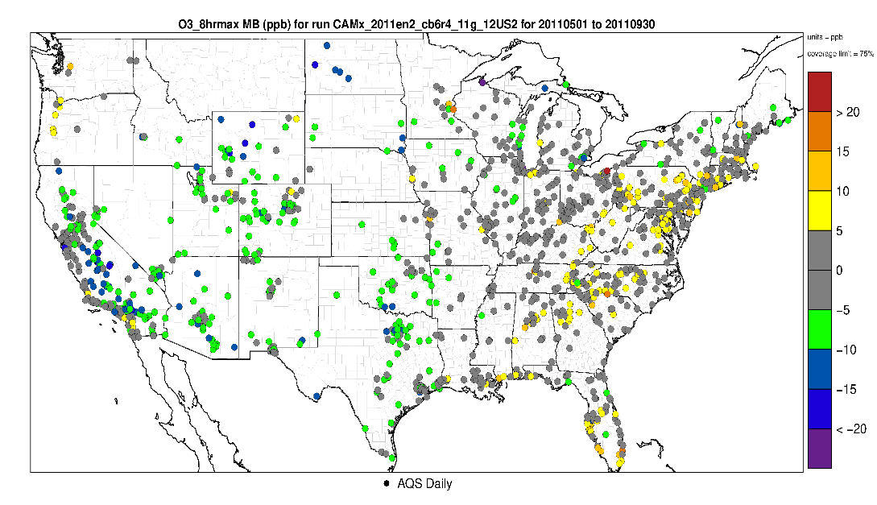
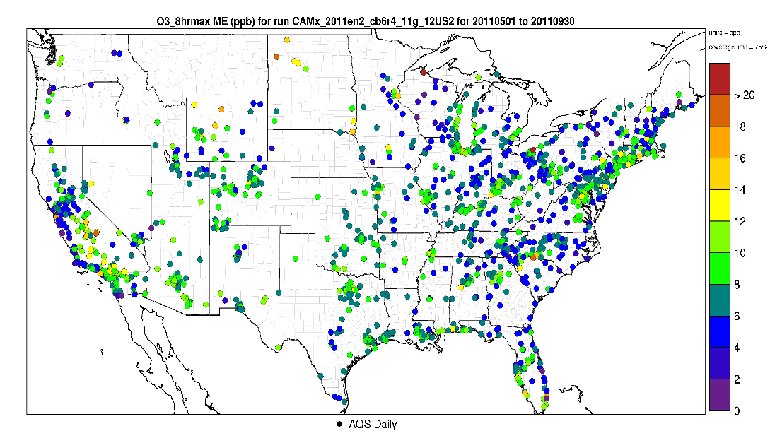
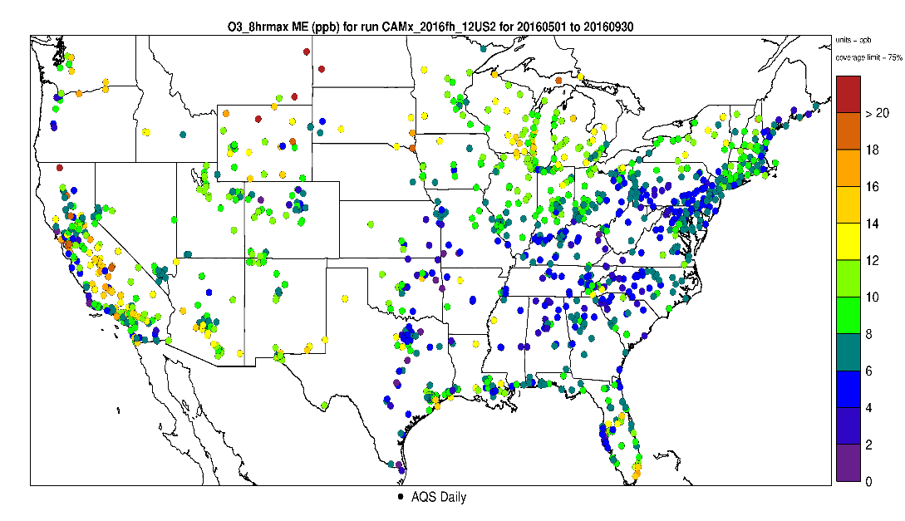
CAMx May – September MDA8 O3 > 60 ppb
2011 & 2016
2011
2016
<= Mean =>
Bias
<= Normalized =>
Mean
Bias
Notes:
The performance in the western portion of the US seems in 2016 seems to be fairly consistent with the performance in 2011, overall.
In the East, the tendency for over prediction from the Southeast to the Northeast in 2011 is not evident in 2016. However, in 2016 model bias is somewhat greater compared to 2011 in portions of the Midwest.

Slide 27
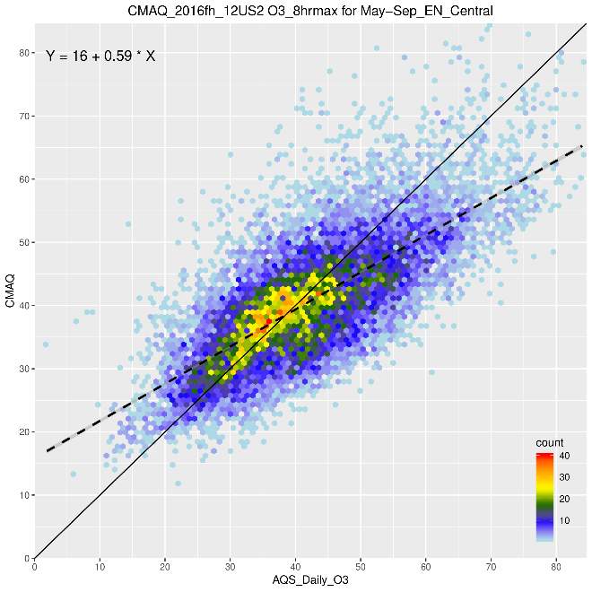
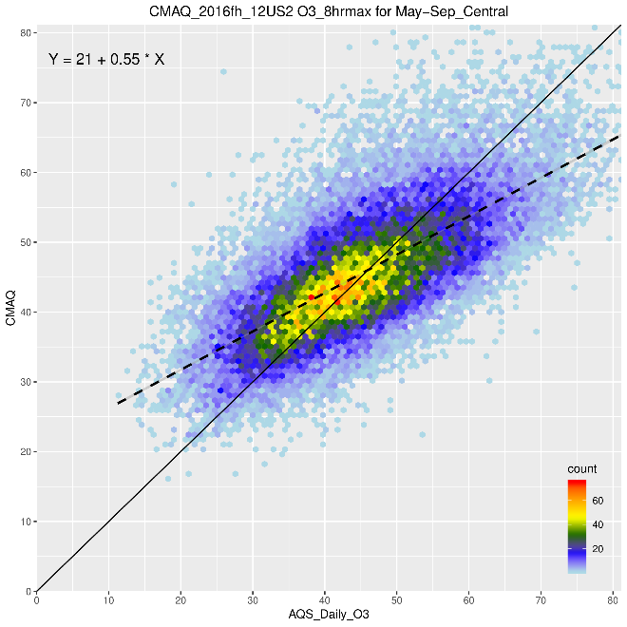
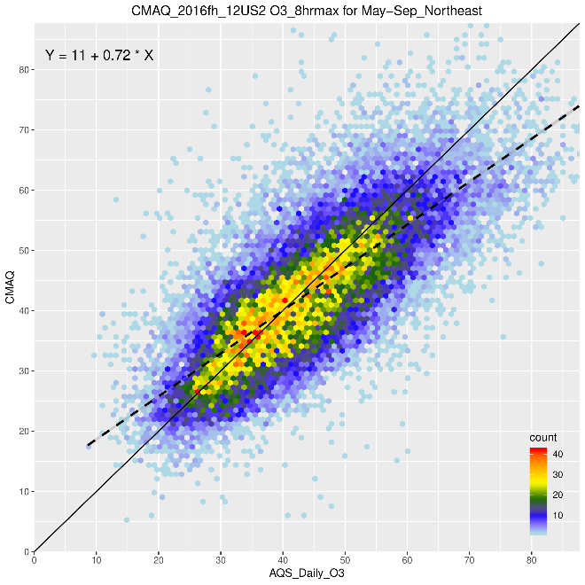
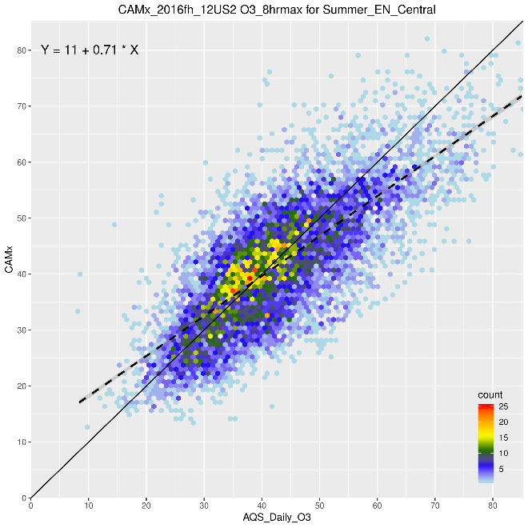
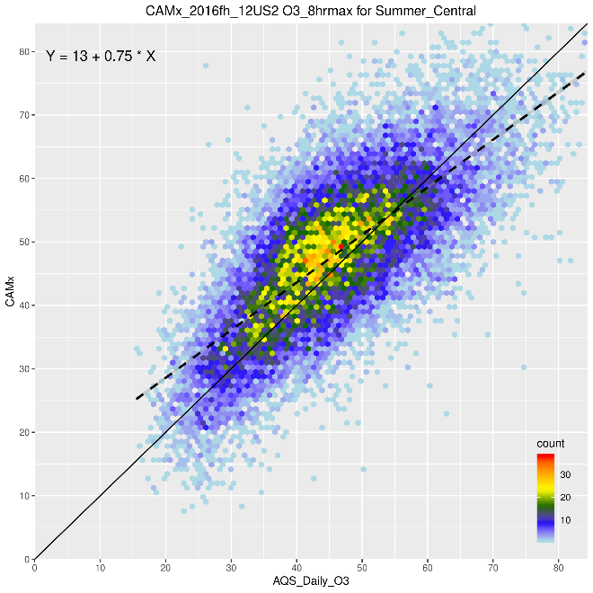
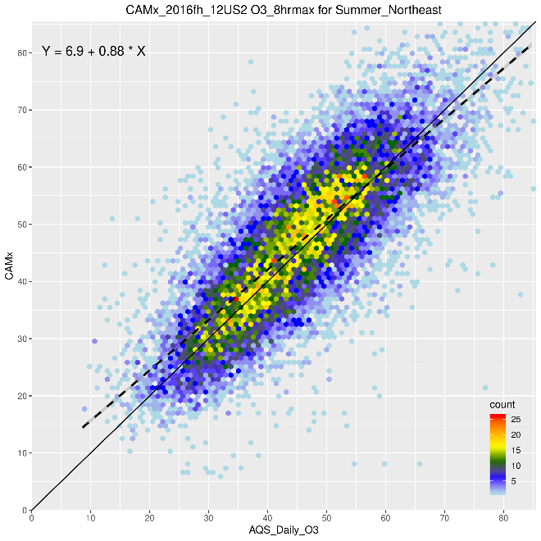
MDA8 O3 Density Scatter Plots by Region for Summer
CMAQ =>
Midwest
Ohio Valley
Northeast
CAMx =>
Midwest
Ohio Valley
Northeast
Notes:
In these three regions, CMAQ has a higher density of pairs along the 1:1 line, compared to CAMx.
However, obs/predicted pairs for CAMx tend to follow more closely the 1:1 line throughout the distribution more so that CMAQ.
Also, while CMAQ tends to under predict the upper end of the distribution, CAMx tends to over predict in this range.

Slide 28
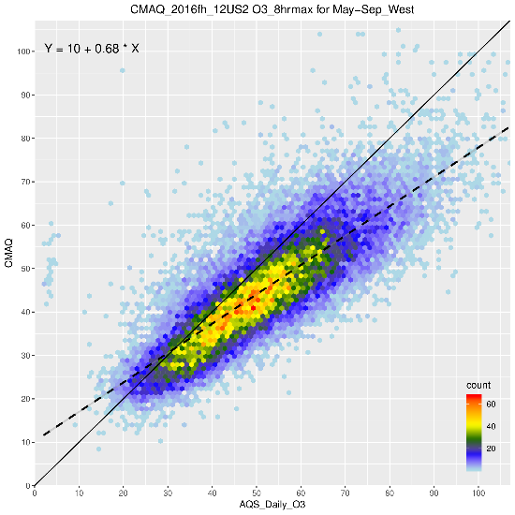
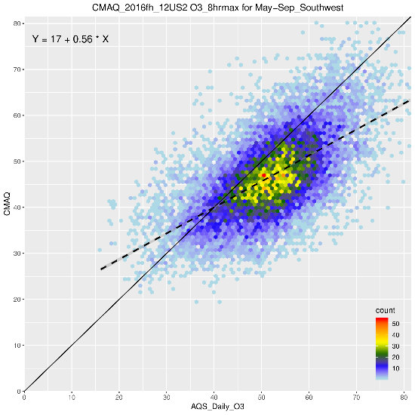
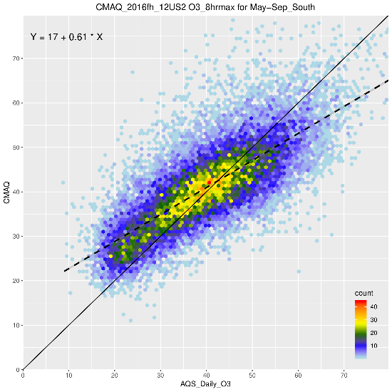
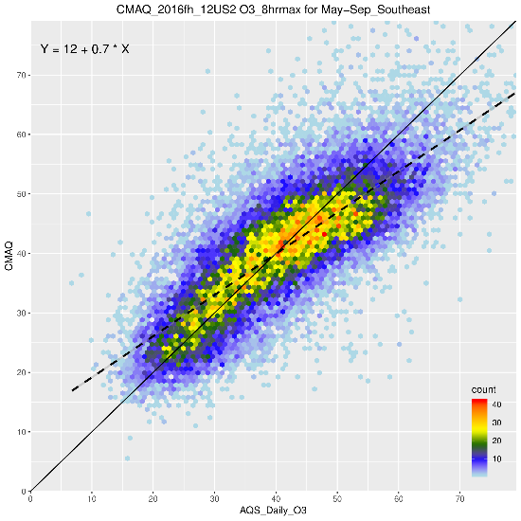
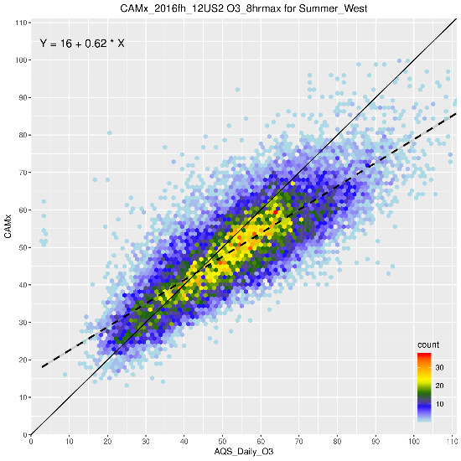
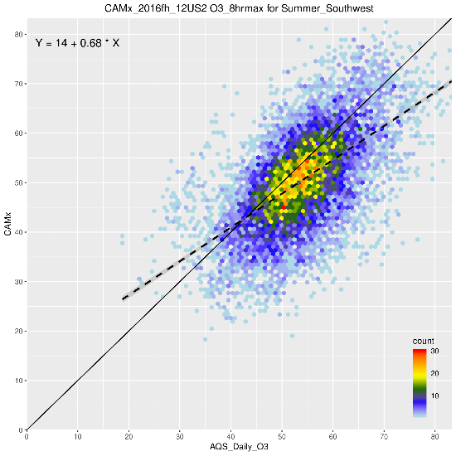
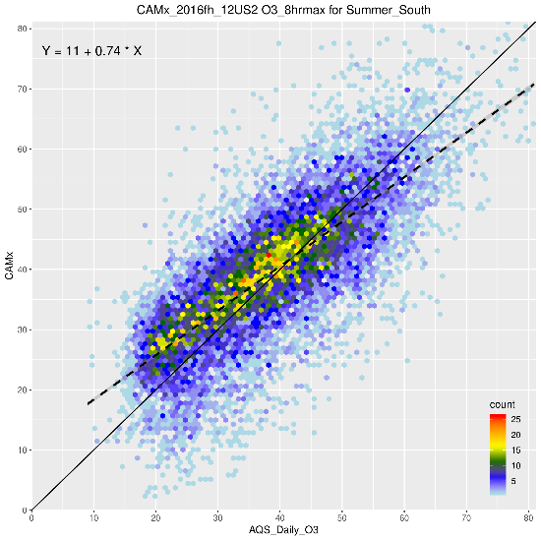
MDA8 O3 Density Scatter Plots by Region for Summer
CMAQ =>
West
Southwest
South
Southeast
CAMx =>
West
Southwest
South
Southeast
Notes:
The differences between CMAQ and CAMx for the Southeast and South regions are similar to what we see in the Northeast and Ohio Valley regions.
In the Southwest, the obs values at the low end of the distribution are higher by 20 ppb or so compared to the obs values in other regions. Both models capture this regional characteristic.
In the West, both models under predict at the high end of the distribution – driven largely by the obs/predicted pairs in California.

Slide 29
Select ozone Sensitivities: Ohio Valley Region
Notes:
GEOS-Chem and Noah-YSU sensitivities increases ozone making underpredictions in May/June better and overpredictions in Jul-Sep worse
Speciation, kzmin and WRFv411 sensitivities have little impact

Slide 30
Select ozone sensitivities: Northeast Region
Notes:
GEOS-Chem sensitivity increases ozone making underpredictions in May/June better and overpredictions in Jul-Sep worse
Speciation, kzmin, Noah-YSU and WRFv411 sensitivities have little impact

Slide 31
Select ozone sensitivities: South Region
Notes:
GEOS-Chem and Noah-YSU sensitivities increases ozone making overpredictions in Jul-Sep worse
Speciation, kzmin and WRFv411 sensitivities have little impact

Slide 32
Select ozone sensitivities: Southwest Region
Notes:
GEOS-Chem and Noah-YSU sensitivities increases ozone making underpredictions better
Speciation, kzmin and WRFv411 sensitivities have little impact

Slide 33
Findings
CMAQ and CAMx tend to under predict MDA8 ozone > 60 ppb during the spring and summer.
Both CAMx and CMAQ under predict MDA8 ozone > 60 ppb at individual monitoring sites nationwide; more so in the West compared to the East.
CMAQ tends to have a greater regional extend of under prediction in the East compared to CAMx
Both models tend to under predict at the higher obs concentrations and over predict lower obs; CMAQ more so that CAMx
Both models under predict the seasonal increase in ozone from winter through spring, but over predict the drop in obs values in July-August-September in the Northeast, Ohio Valley, and Midwest.
Both models capture the April through October monthly temporal pattern in the Southeast and Southwest, with some under/over prediction depending on the month and model.
In the Southwest and West, both models tend to under predict the inter-quartile range of MDA8 in nearly all months
Sensitivity simulations
GEOS-Chem and Noah-YSU sensitivities generally increase ozone making underpredictions better and overpredictions worse
Other sensitivities had lesser impact on ozone bias

Slide 34
Next steps
More in depth evaluation of CMAQ an CAMx sensitivity simulations
Evaluation of gas-phase precursors
NOx (see extra slides)
SO2
CO
VOCs

Slide 35
Additional Slides

Slide 36
EPA AQ Modeling Inputs and Set-up
component | Details | Reference
Emissions case | 2016v1 (2016fh)* | http://views.cira.colostate.edu/wiki/wiki/9169
Meteorology | WRF v3.8 | http://views.cira.colostate.edu/wiki/Attachments/Inventory%20Collaborative/Documentation/2016beta_0311/MET_TSD_2016.pdf
Meteorology post-processing | wrfcamx; MCIP v4.3 (“16j”) | http://www.camx.com/files/camxusersguide_v6-50.pdf; https://www.geosci-model-dev.net/3/243/2010/gmd-3-243-2010-discussion.html
IC/BC | 2016fe hemispheric CMAQv5.2.1 paired with CMAQ/CAMx 36US3 CONUS | https://cmascenter.org/conference//2018/slides/0850_henderson_hemispheric-cmaq_application_2018.pptx
Model (chemical mechanism) | CAMx v7 beta (cb6r4_CF); CMAQv5.3.1 (cb6r3/AERO7)** | http://www.camx.com/; https://www.epa.gov/cmaq/cmaq-models-0
domains | 36US3 & 12US2 CONUS
Layers | 35 vertical layers (no layer collapsing)
*With updates to CMV
**Note CMAQv5.3.1 bug preventing use of certain types of emissions files

Slide 37
Base Simulation CMAQv5.3.1 Science Options
Updated to AERO7for PM treatment; Marine halogen O3 destruction
MECH [default: none] | cb6r3_ae7_aq
CTM_OCEAN_CHEM [default: Y] | Y
CTM_LTNG_NO [default: Y] | N
CTM_WB_DUST [default: N] | N
CTM_WVEL [default: Y] | N
KZMIN [default: Y] | Y
PX_VERSION [default: Y] | Y
NOAH_VERSION [default: N] | N
DepMod | M3DRY
CTM_MOSAIC [default: N] | N
CTM_BIDI_FERT_NH3 [default: Y] | N
CTM_ABFLUX [default: Y] | N
CTM_HGBIDI [default: N] | N
CTM_SFC_HONO [default: Y] | Y
CTM_GRAV_SETL [default Y] | Y
CTM_BIOGEMIS [default: Y] | N
Tested different configurations impact on mixing
Tested different bidi configurations

Slide 38
CAMxv7.0 “beta 6” Science Options
Diagnostic_Error_Check | FALSE
Flexi_Nest | FALSE
Advection_Solver | PPM
Chemistry_Solver | EBI
PiG_Submodel | NONE
Probing_Tool | NONE
Chemistry | TRUE
Drydep_Model | ZHANG03
Bidi_NH3_Drydep | FALSE
Wet_Deposition | TRUE
ACM2_Diffusion | FALSE
Surface_Model | FALSE
Inline_Ix_Emissions | TRUE
Super_Stepping | TRUE
Gridded_Emissions | TRUE
Point_Emissions | TRUE

Slide 39
WRF Set-Up
Model Version | v3.8
Physics Options | Pleim-Xiu land surface model; ACM v2 boundary layer scheme; Kain-Fritch; cumulus parameterization with moisture-advection trigger; Morrison double moment microphysics; RRTMG longwave and shortwave radiation schemes;
36 NOAM domain Initialization | 0.25-degree GFS analysis and 3-hour forecase from 00Z, 06Z, 12Z, 18Z
12 US domain Initialization | 12 km NAM; 40 km EDAS where NAM data were not available
Analysis Nudging | temperature, wind, and moisture above the boundary layer
Deep soil moisture initialization | ipxwrf program
Landuse and land cover | 36 NOAM domain: USGS; 12 US domain: 2011 NLCD
Sea surface temperatures | GHRSST at 1 km resolution
Other | Lightning data assimilation for characterizing deep convection

Slide 40
NOx

Slide 41
NOx spatial patterns in CMAQ and CAMx
CAMx
CMAQ
January
July

Slide 42
CMAQ
CAMx
Unbiased or slightly underpredicted NOx in all regions for Fall/Winter/Spring in both CMAQ and CAMx
Summer bias between +/-20% except
Slight overprediction in South for both models
Slight overpredictions in Southeast for CAMx
Slight underprediction in NRockiesPlains in both models
Overpredicted all seasons in the Northwest (only 2 monitors)

Slide 43
Winter NOx NMB (%)
CMAQ
CAMx
Small to moderate underpredicted NOx in all regions for both CMAQ and CAMx
Overpredicted all seasons in the Northwest (only 2 monitors; Seattle monitor hard to model due to complex coastal meteorology)

Slide 44
Summer NOx NMB (%)
CMAQ
CAMx
Slight overprediction in South for both models
Slight underprediction in NRockiesPlains in both models
Overpredicted all seasons in the Northwest (only 2 monitors; Seattle monitor hard to model due to complex coastal meteorology)

Slide 45
Geos-Chem BCs Sensitivity Simulations: NOx
CAMx: GEOSChem - Base
CMAQ: GEOSChem - Base
January
July

Slide 46
Additional CMAQ sensitivities: NOx
WRFv4.11 - Base
NoahYSU - Base
Lightning NO - Base
January
July

Slide 47
PM2.5

Slide 48
CSN speciated PM2.5 performance: Northeast
Winter
Summer
CSN
CMAQ
CAMx
CSN
CMAQ
CAMx

Slide 49
CSN speciated PM2.5 performance: Upper Midwest
Winter
Summer
CSN
CMAQ
CAMx
CSN
CMAQ
CAMx

Slide 50
CSN speciated PM2.5 performance: Ohio River Valley
Winter
Summer
CSN
CMAQ
CAMx
CSN
CMAQ
CAMx

Slide 51
CSN speciated PM2.5 performance: Southeast
Winter
Summer
CSN
CMAQ
CAMx
CSN
CMAQ
CAMx

Slide 52
CSN speciated PM2.5 performance: South
Winter
Summer
CSN
CMAQ
CAMx
CSN
CMAQ
CAMx

Slide 53
CSN speciated PM2.5 performance: Northern Rockies and Plains
Winter
Summer
CSN
CMAQ
CAMx
CSN
CMAQ
CAMx

Slide 54
CSN speciated PM2.5 performance: Northwest
Winter
Summer
CSN
CMAQ
CAMx
CSN
CMAQ
CAMx

Slide 55
CSN speciated PM2.5 performance: Southwest
Winter
Summer
CSN
CMAQ
CAMx
CSN
CMAQ
CAMx

Slide 56
CSN speciated PM2.5 performance: West
Winter
Summer
CSN
CMAQ
CAMx
CSN
CMAQ
CAMx

Slide 57
CMAQ comparison to MODIS AOD: methods
RSIG
Product: modis.mod43k.Optical_Depth_Land_And_Ocean
AOD at 500nm
Regrid: 12US2 via WCS
CMAQ
Variable AOD_W550_ANGST from PHOTDIAG1
Angstrom exponent interpolation between 381 and 607 nm
Filter grid cells:
Select approximate overpass times
Select only successful retrieval time/grid cells.
Average all data to monthly resolution

Slide 58
How does CMAQ compare to MODIS AOD?
AOD comparison methods in extra slides
Remer et al. 2005 suggest uncertainty at the
+- 0.05
+-15% AOD
So good performance
CMAQ > (MODIS * 0.85 – 0.05)
CMAQ < (MODIS * 1.15 + 0.05)
When |DIFF| < 0.05, good.
When |1 – RATIO| < 0.15, good
Comparisons with satellite products is still a work in progress
Notes:
Remer et al. 2005 suggest uncertainty at the 15% +- 0.05tau

